Slide 1

Adapt to Endure: The New HR Playbook
Allison Vaillancourt, PhD
Vice President, Organizational Effectiveness
December 10, 2025

Slide 2
Agenda
Naming The Disruptions
The Uncertainty Response
The Adaptability Imperative

Slide 3

Poll Question One
3

Slide 4
Poll Question Two
4

Slide 5
A Few Words on Disruption
5

Slide 6
Key Concept
Disruption is the event or force.
Uncertainty is the condition.
Disruption is the storm.
Uncertainty is the fog.

Slide 7
Key Concept
Disruption challenges systems;
leadership defines outcomes.

Slide 8
Higher Ed Disruption
Disruption is both acute and slow-moving
Political
Economic
Technological
Demographic

Slide 9
Jeopardy: Abbreviated Name That Curveball Edition

Slide 10
Jeopardy Abbreviated Name That Curveball Edition
Show Me the Money | What Used to Be True | That Can’t Be Good
$500 | $500 | $500
$1000 | $1000 | $1000

Slide 11

Show Me the Money: $500
This caused colleges and universities to lose an estimated $3 billion in revenue in 2025

Slide 12
Show Me the Money: $1000
Will make it increasingly difficult for medical students to afford their degrees

Slide 13
What Used to Be True: $500
Were long seen as a reliable source of tuition revenue

Slide 14
What Used to Be True: $1000
This qualification was typically required for incoming higher education presidents

Slide 15
That Can’t Be Good: $500
Individuals now average three years in these higher education roles

Slide 16
That Can’t Be Good: $1000
The missing leadership behavior that faculty and staff have identified as their top frustration this year

Slide 17
A Few More Words on Disruption
17

Slide 18
It’s Been a Volatile 2025
Since January, President Trump has issued numerous executive orders, memoranda and proclamations
The uncertainty around the frequent policy changes and subsequent legal actions has increased volatility
Higher education leaders are challenged to navigate constantly evolving rules of the game

Slide 19
Poll Question Three
19

Slide 20
Average Executive Orders by Year

Slide 21
Poll Question Four
21

Slide 22
217 Executive Orders in 2025
Note: Some executive orders cover more than one topic
Source: Ballotpedia

Slide 23
Areas of High Education Impact
Workforce and Skills-Based Training
Title IX
Research Funding
Federal Financial Aid
International Students and Research
Accreditation
Department of Education Status
Restricting Institutional Autonomy
Undocumented Students and Employees
Diversity, Equity and Inclusion

Slide 24
How Do We Respond to Disruption and Uncertainty?
24

Slide 25
Common Responses to Uncertainty
Psychological Response
Heightened anxiety
Sensemaking
Cognitive overload
Fear
Behavioral Response
Avoidance
Over control
Risk taking or Impulsivity
Hand-wringing
Social Response
Seeking reassurance
Shifts in trust — Inner circle vs Outer circle
Under or over-communicating

Slide 26
How are reactions to disruption and uncertainty showing up at your institution?
26

Slide 27
What is Uncertainty Was an Opportunity for Growth?
Psychological Response
Heightened anxiety
Sensemaking
Cognitive overload
Fear
Behavioral Response
Avoidance
Over control
Risk taking or Impulsivity
Hand-wringing
Social Response
Seeking reassurance
Shifts in trust — Inner circle vs Outer circle
Under or over-communicating
Growth Response
Resilience and adaptability
Creativity and innovation
Learning orientation
Teamwork

Slide 28
How Can We Adapt to Constant and Often Surprising Change?
28

Slide 29
5 Steps To ADAPT to Disruption and Uncertainty
Authenticity
Share openly and honestly, even when answers are unclear
Discernment
Cut through complexity to focus on what matters most
Agility
Pivot quickly while keeping priorities in focus
Partnership
Draw strength and wisdom from collaboration with others
Tenacity
Maintain energy, optimism and composure necessary to move forward

Slide 30
Authenticity
Share information openly and honestly, even when outcomes are uncertain
Communicate in a way that creates calm and clarity under pressure
Acknowledge what is unknown while still offering direction and confidence
Notes:
Not wanting to communicate until everything is certain

Slide 31
Discernment
Identify the most important issues when faced with complexity or ambiguity
Make timely, well-reasoned decisions even without complete information
Avoid rushing to simplistic answers when facing ambiguity, weighing risks and opportunities instead

Slide 32

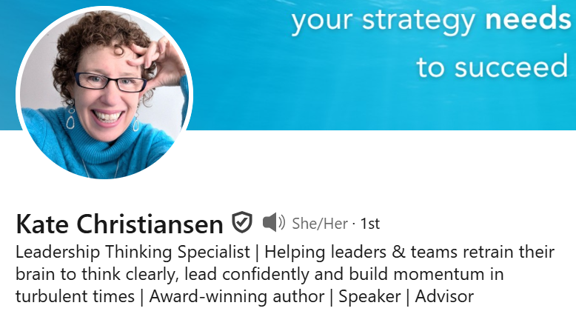
When the world feels overwhelming, our brains do something completely natural.
We reach for certainty.
Any certainty.
It makes sense. Certainty feels safe. It feels like progress. It feels like control.
But there’s a catch.
The faster we reach for certainty, he more we risk grabbing an answer – any answer – just to feel better…
But real leadership – real progress often requires staying with the discomfort of not know a little longer than we want to.

Slide 33
Agility
Pivot effectively when circumstances change
Adjust priorities quickly while keeping attention on the big picture
Respond constructively to setbacks, reframing challenges as opportunities

Slide 34
Partnership
Actively seek input from others before making key decisions
Create a climate of trust and collaboration during uncertain times
Build shared ownership of challenges and solutions

Slide 35
Tenacity
Maintain steady energy and composure during prolonged challenges.
Demonstrate optimism that helps others remain confident
Encourage learning and growth by framing uncertainty as opportunity

Slide 36
5 Steps To ADAPT to Disruption and Uncertainty
Authenticity
Share openly and honestly, even when answers are unclear
Discernment
Cut through complexity to focus on what matters most
Agility
Pivot quickly while keeping priorities in focus
Partnership
Draw strength and wisdom from collaboration with others
Tenacity
Maintain energy, optimism and composure necessary to move forward

Slide 37
Poll Question Five
37

Slide 38
How can your HR team ADAPT?
38

Slide 39
Some Words to Sustain you
“When there’s a big disappointment, we don’t know if that’s the end of the story. It may be just the beginning of a great adventure.”
– Pema Chodron
"We often avoid taking action because we think ‘I need to learn more,’ but the best way to learn is often by taking action."
– James Clear
“The misstep doesn’t define you. Your next move does.”
– Sahill Bloom
Notes:
Allison: Wrap up comments

Slide 40
Connect with me on LinkedIn!
Allison Vaillancourt, PhD
Vice President, Organizational Effectiveness
Segal
Availlancourt@segalco.com
40

