Slide 1
Western Michigan University’s
Staff Leadership Development Program:
How to build your own

Slide 2
Western Michigan University’s
Staff Leadership Development Program:
How to build your own
Or

Slide 3
Western Michigan University’s
Staff Leadership Development Program:
How to build your own
Or
“What was old is now new again!”

Slide 4
Dr. Daniel J. Hurley has been serving as the Chief Executive Officer of the Michigan Association of State Universities (MASU) since 2015. MASU serves as the coordinating board for Michigan’s 15 public universities, providing advocacy and fostering policy to maximize the collective value these institutions provide in serving the public interest and the state of Michigan. Hurley has returned to the Association where he served from 2003-2007 as its director of university relations. From 2007-2015, he served as the associate vice president for government relations and state policy for the American Association of State Colleges and Universities (AASCU), based in Washington, D.C. For the past 25 years, Hurley has worked directly on behalf of public university presidents and other campus leaders at the institutional, state, and national level, providing support aimed at helping them advance the universities’ missions.

Slide 5
The Michigan Association of State Universities (MASU) serves as the coordination board for Michigan’s 15 public universities, providing advocacy and fostering policy to maximize the collective value these institutions provide in serving the public interest and the state of Michigan.

Slide 6
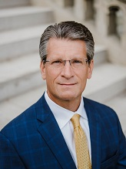
Dr. Daniel J. Hurley, CEO

Slide 7
https://us06web.zoom.us/j/88021205849?pwd=Q0JYbURFVE9ia2ZRODdSNGhyb1ByZz09

Slide 8
* Introduced at Ferris State University in 2000 as part of a two-pronged professional development initiative
* Based upon community leadership programs
* Continued annually for thirteen years at FSU – included access for all full-time employment groups
* Winner of Mid-West CUPA-HR “best practices” award for 2001
* Multiple CUPA-HR presentation (Michigan, Mid-West & National), SCUP and Michigan State Chamber (community leadership prgms)

Slide 9
So, how does this work?
* Program goals
- Provide practical leadership training;
- Offer participants an opportunity for better understanding of their institutions and how they work;
- Develop a strong, functional cohort

Slide 10
So, how does this work?
* Program development
- Utilize internal resources;
University subject experts
Campus locations (unique/varied)
- Minimal costs;
- Develop a strong, functional cohort

Slide 11
So, how does this work?
* Participant selection
- Eligible employment groups
- Size of cohort
- Open registration – application process
- Select based on cross-section of represented divisions/departments

Slide 12
So, how does this work?
* Participant commitment
- One day per month for academic year
Some full and some half days
- Ask for and receive permission from supervisor
- Agree to not miss more than one session
- (Too many applicants? – priority for another year)

Slide 13
So, how does this work?
* Content
- Original model based upon community leadership programs
- Have a planned 1st and final session
Challenge course
Other group participation
- Specific training
- Information
- Interaction

Slide 14
Community Leadership Programs
Survey/inquire if you have faculty or staff who are past alums of these programs

Slide 15
Challenge Courses
- Availability
Low elements

Slide 16
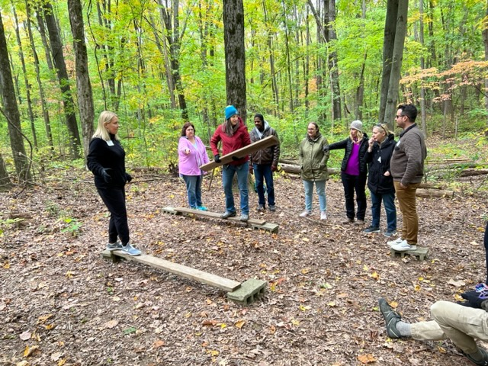

Slide 17
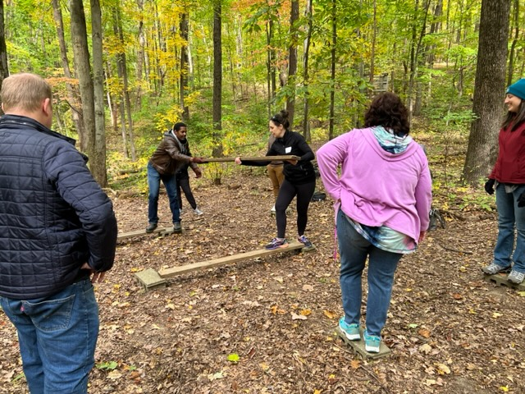

Slide 18
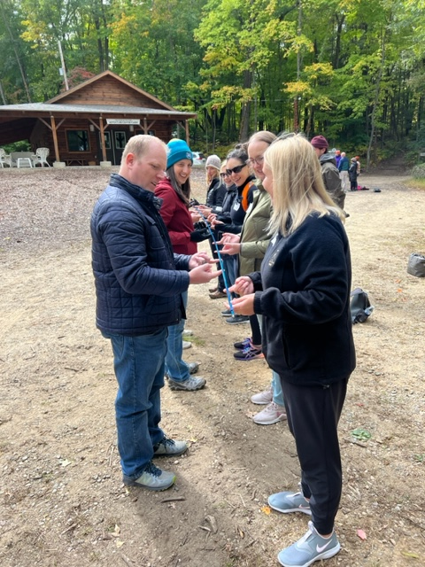

Slide 19
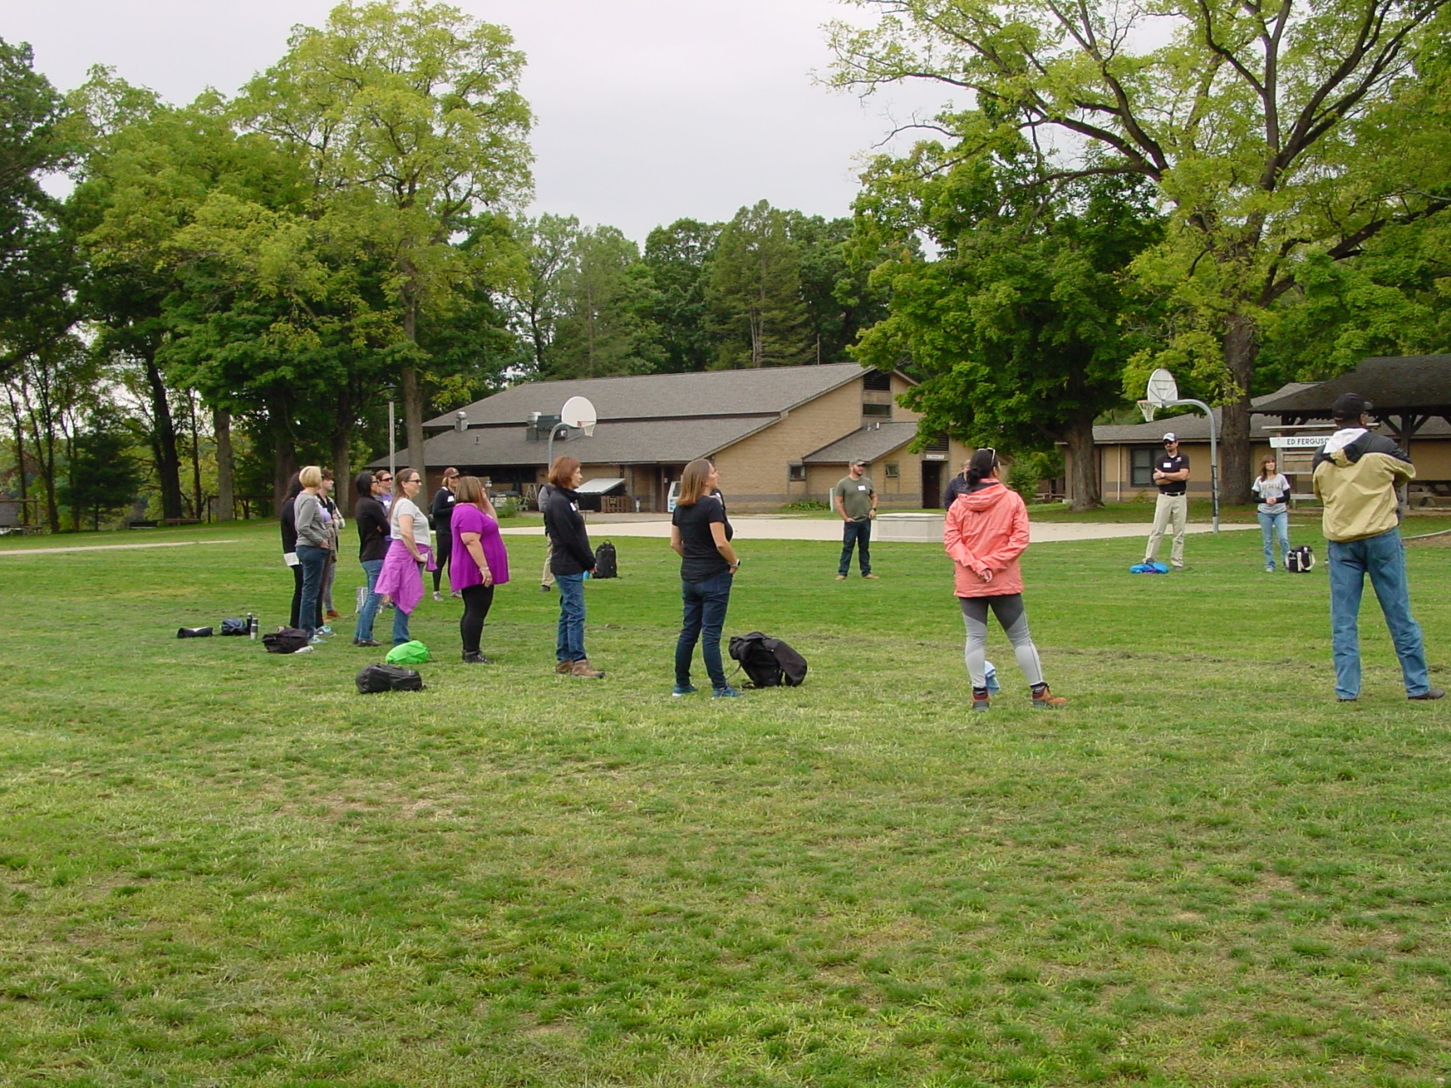

Slide 20
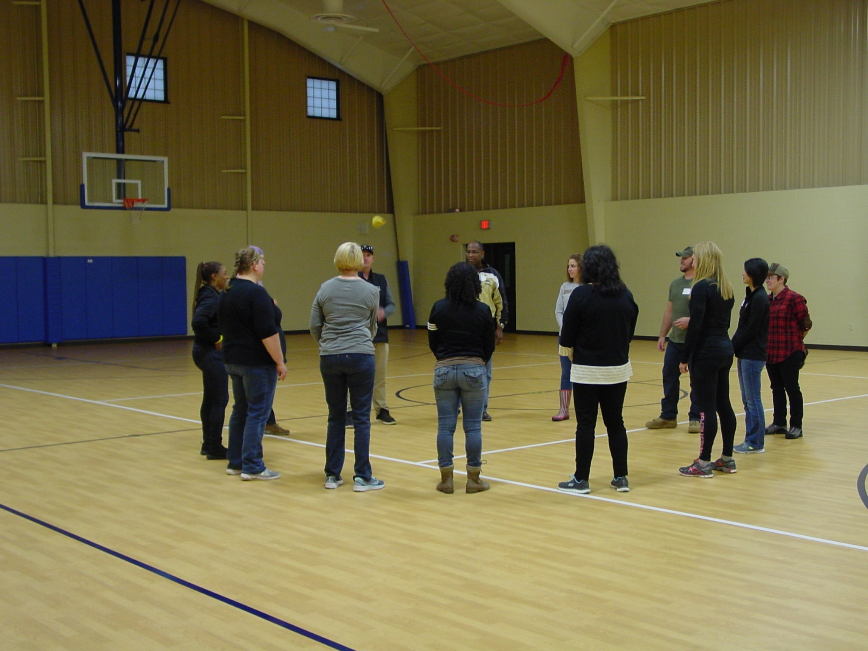

Slide 21
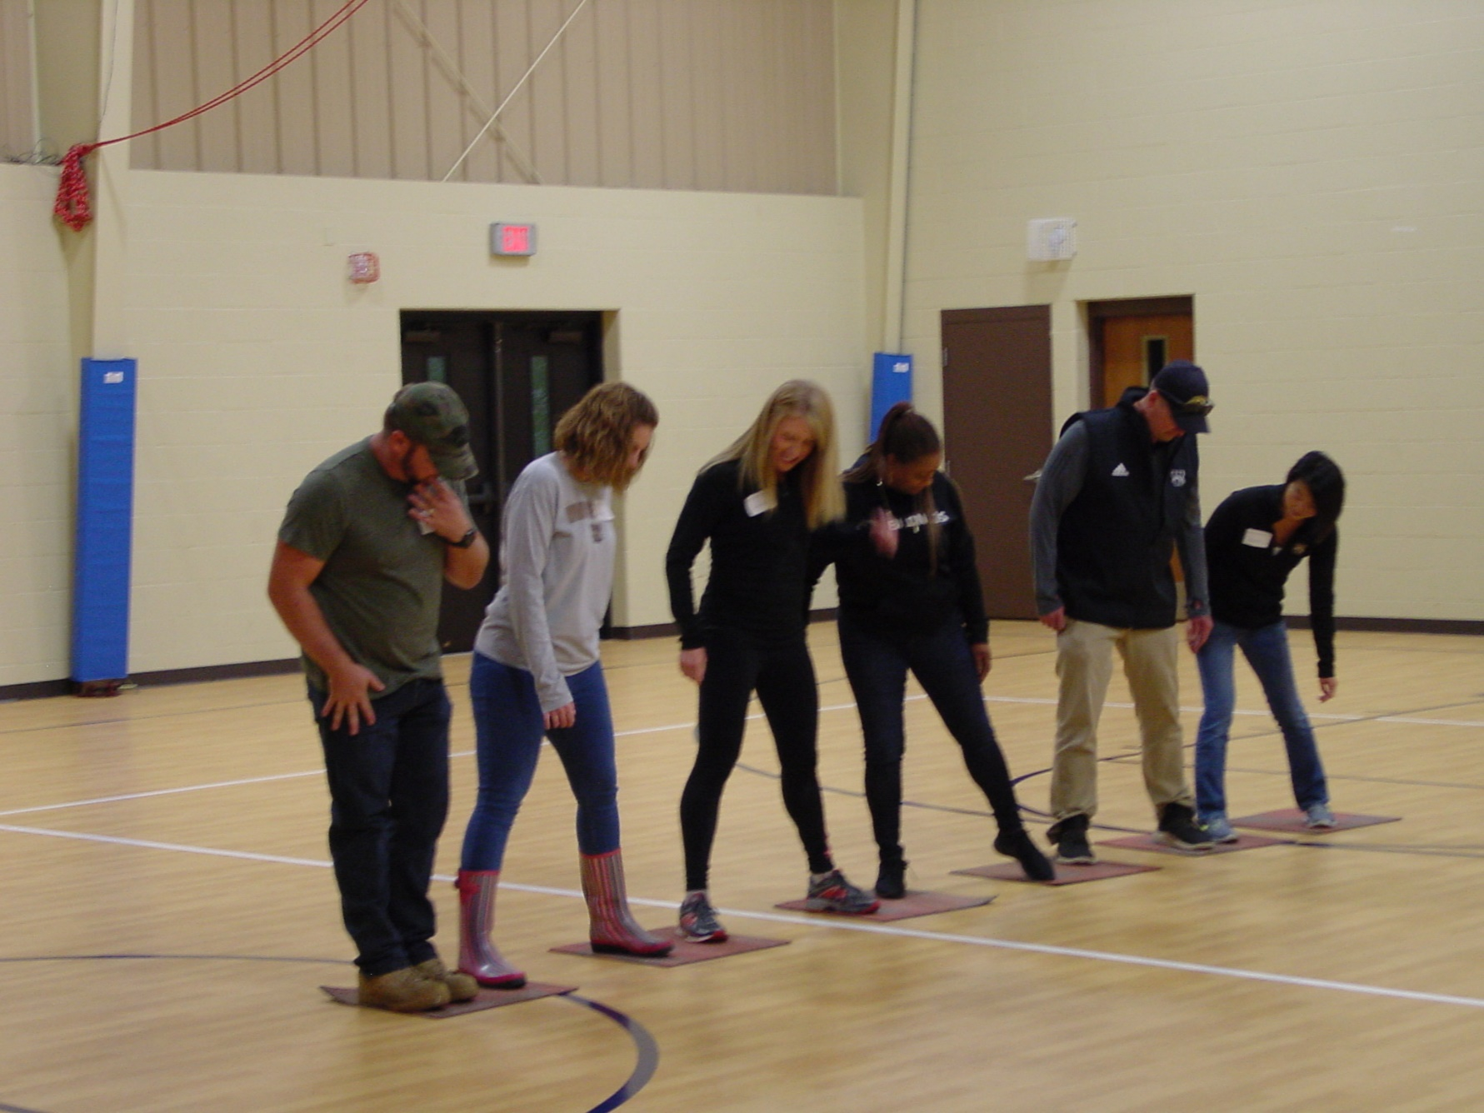

Slide 22
Challenge Courses
- Availability
Low elements (1st session)
High elements (Final session)

Slide 23
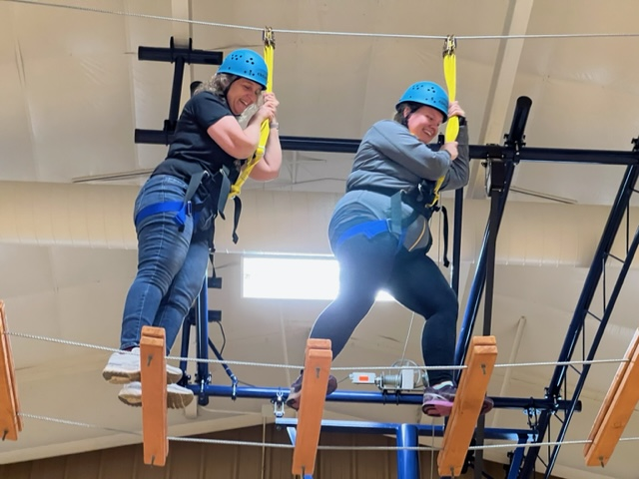

Slide 24
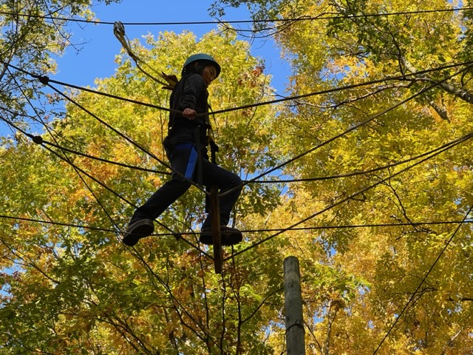

Slide 25
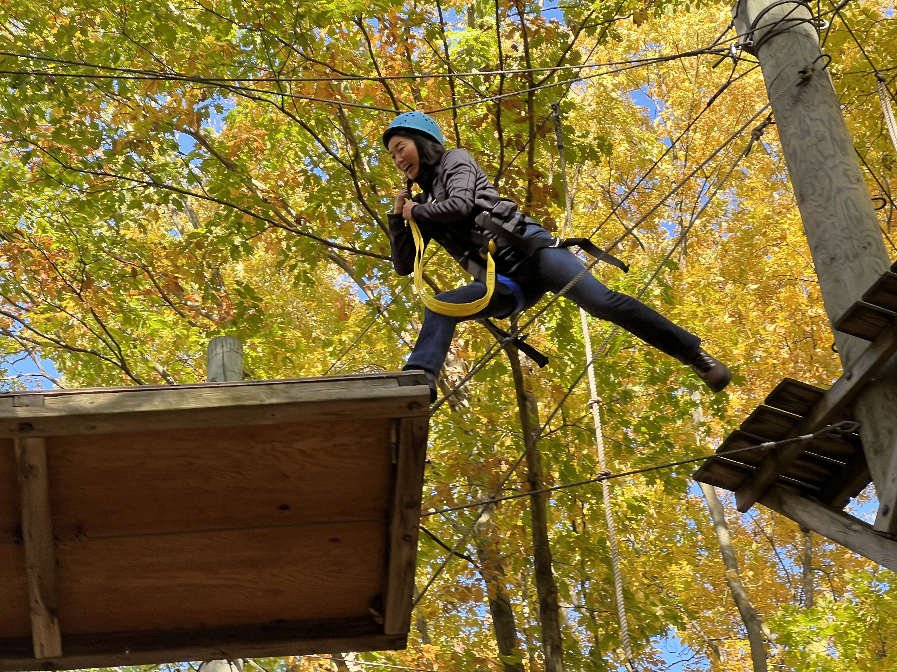

Slide 26
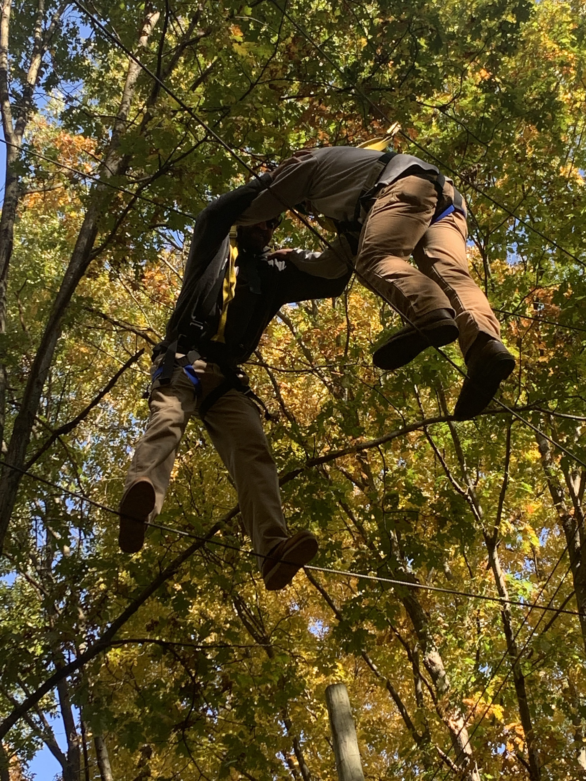

Slide 27
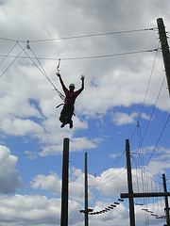

Slide 28
Group leadership training
- Experiential/project training
https://hrdqstore.com/collections/leadership-training

Slide 29
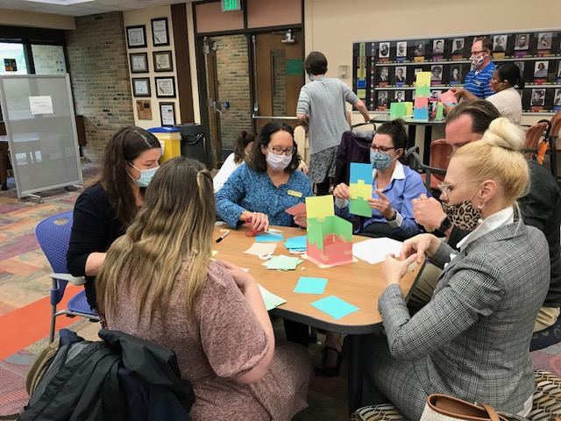

Slide 30
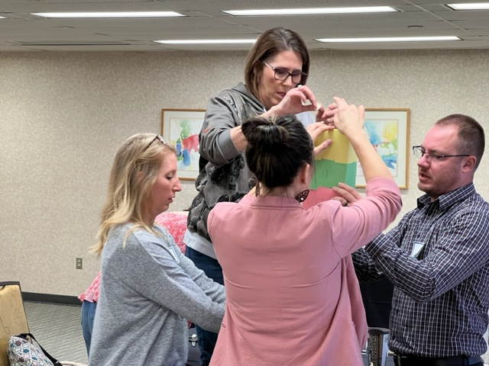

Slide 31
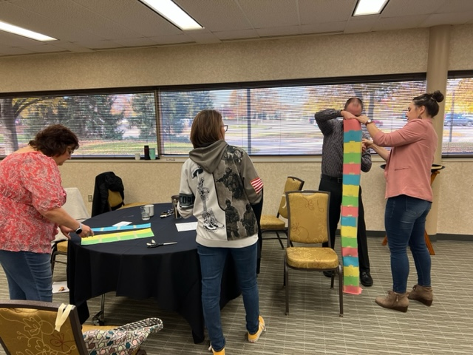

Slide 32
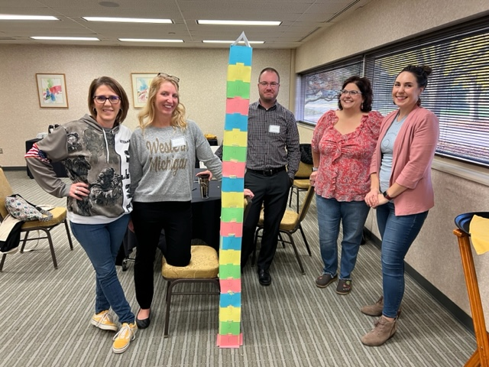

Slide 33
Other Content Subjects and Events
-MASU update

Slide 34
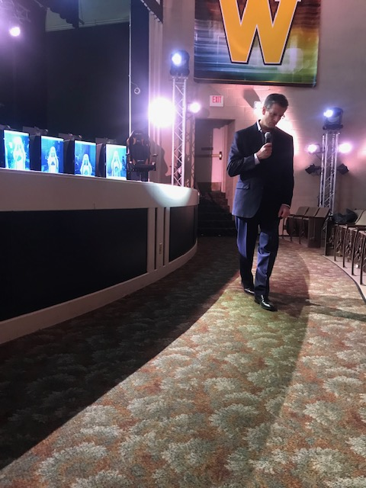

Slide 35
Other Content Subjects and Events
- MASU update
- Finance/budget presentation
- Collective bargaining/ contract maintenance
- Employee relations
- Employment policies/procedures
- College update

Slide 36
Other Content Subjects and Events
- Unique programs, facilities, campuses
(Utilize location tours)
Museums
Functional departments
Power plant
Participant responsibilities
(Who’s participating)
- Skills training
Dispute resolution
Team leadership

Slide 37
Leadership Participation
- Session dedicated to leadership
“conversations”
One hour
1st 20 minutes on that week
Questions from participants
Open dialog
President
Vice Presidents
Deans

Slide 38
Graduate and Celebrate!
- Graduation event with President
Breakfast
Slideshow of session photos
Awards

Slide 39
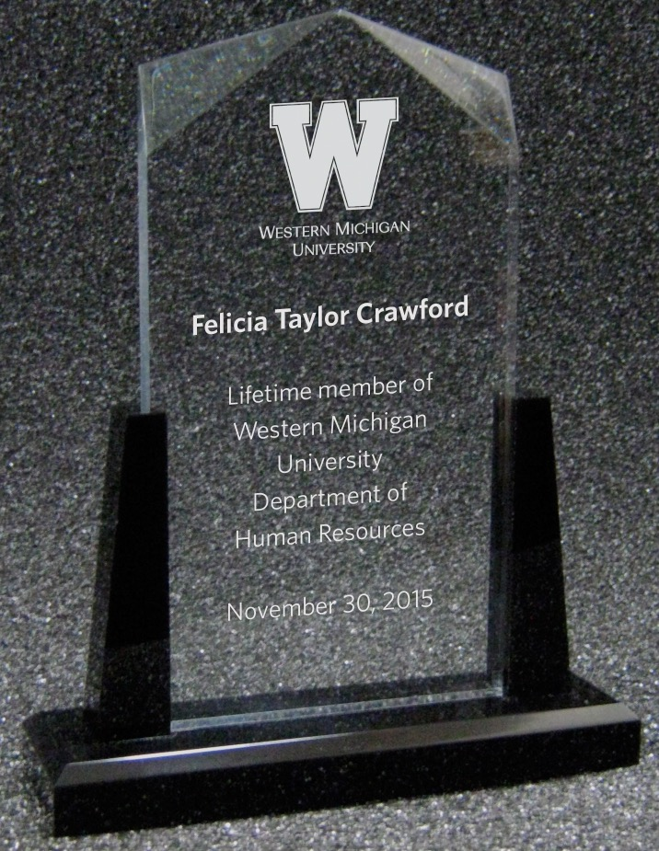

Slide 40
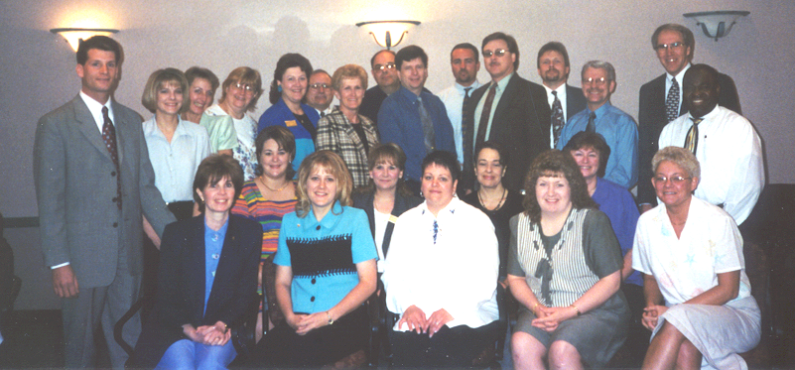

Slide 41
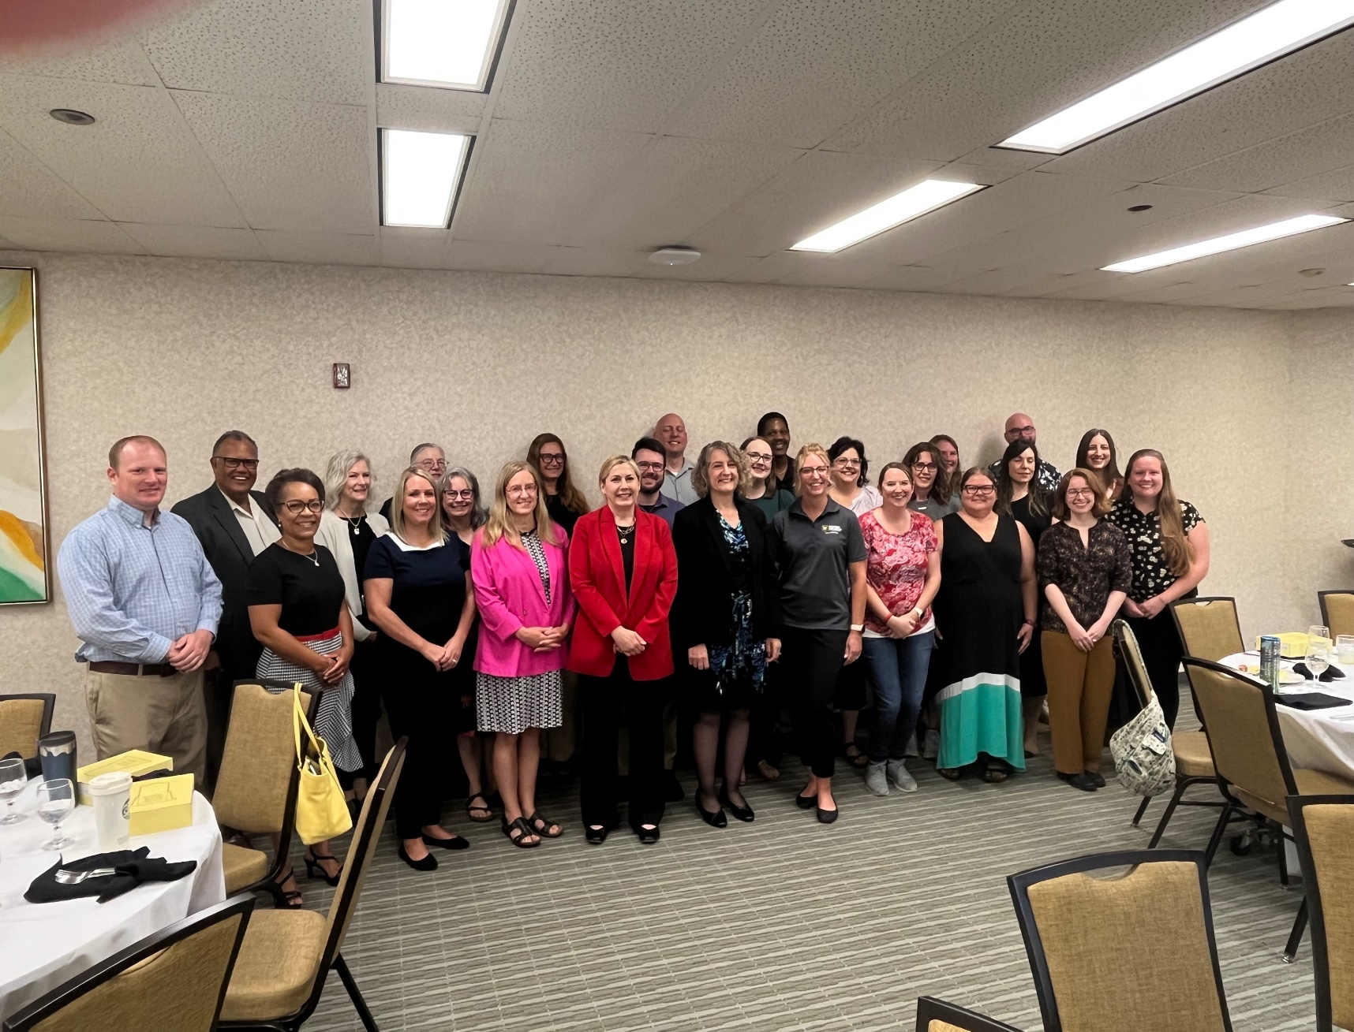

Slide 42
Notes
- Flexible schedule
- Feedback
Survey every session and end of program
Likes and dislikes
Do this session again?
Location(s)?
Any other ideas/suggestions

Slide 43
Notes
- What’s next
Selection of graduates for for cross-functional project team

Slide 45
Your questions and comments

