Slide 1
Welcome!
MICHIGAN CUPA-HR
Thursday, July 27, 2023
Notes:
Hello! And welcome to the 2023 MICHIGAN CUPA-HR CONFERENCE: The HR Evolution. We’re so happy that you’ve been able to take a pause during your work week for learning and development with HR colleagues.

Slide 2

2023 MI CUPA-HR CONFERENCE
Remaining Relevant: A Focus on HR Agility
Notes:
Once again, welcome – my name is Rachel Wiertella and I am an Administrative Manager at Michigan Medicine, as well as President-Elect of Michigan CUPA-HR and am honored to be Communication Chair of this year’s conference planning team. Today’s session topic is Remaining Relevant: A Focus on HR Agility.
The past few years have brought to the forefront the importance of HR practitioners to learn or enhance their competency in the area of flexibility and agility to meet the quickly changing and evolving needs of their stakeholders. The session will focus on flexibility and agility as a key HR competency and how mastering it will keep HR an integral part of strategic decision-making and remain relevant during times of change and evolution. Participants will learn how to improve their flexibility and agility as well as hear about current flexible programs for staff at local colleges and universities that have taken into consideration hybrid work environments.

Slide 3
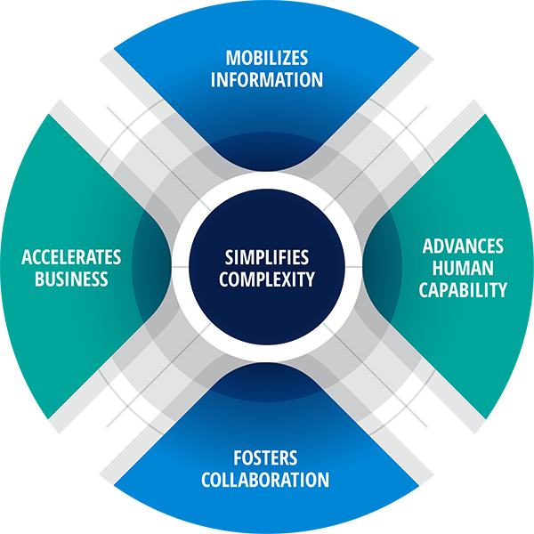
2023 Michigan CUPA-HR Conference
Remaining Relevant: A Focus on HR Agility
HRCS-8 HR COMPETENCY MODEL
by Dave Ulrich
Key competencies that enable HR to deliver value
Each domain is an action that an HR professional does
Notes:
We will begin with the importance of agility as a key HR competency and to help us do that, I would like to share with you the HR Competency Model (version 8), by Dave Ulrich, a professor at the Ross School of Business and co-founder of the RBL Group. Dave’s model is based on decades of research and identifies key competencies that enable HR professionals to deliver significant tangible value to the organization we serve.
You may be familiar with Dave’s earlier version which focused on 9 competencies divided into 3 categories: Organization Enablers, Core Drivers, and Delivery Enablers. HRCS-8 is the updated model that focuses on 5 competencies and implies less focus on the role of HR and more on the actions of HR regardless of the role. These are meant to be universal, and apply to HR professionals in strategic leadership as well as those in operational support roles.
HRCS-8 focuses on simplifying complexity with key takeaways including:
Understanding the competencies that are critical for strategic business partnerships that impact business results and on the organization capabilities that HR helps deliver
The five domains identified with this iteration of the competency model and research are - Simplifies Complexity, Mobilizes Information, Fosters Collaboration, Advances Human Capability, and Accelerates Business
HR professionals will still champion diversity, equity, and inclusion as part of this model.

Slide 4

2023 Michigan CUPA-HR Conference
Remaining Relevant: A Focus on HR Agility
HRCS-8 HR COMPETENCY MODEL
by Dave Ulrich
Generate Competitive/Market Insights
Influences the Business
Gets the Right Things Done
Drives Agility
Understand agility and how it can be reflected in your work
The ability to think and act quickly
Notes:
HR is an integral and strategic member of the organization whether it’s recruitment/retention, compensation, benefits, performance management, or consulting - we all perform a role intended to keep business successful and operating at peak performance. Not only is our knowledge of the business and the people keeping that business moving important, but also how external forces and the broader world impact key decisions. This “outside-in” strategy is how HR professionals drive the agility of business, to adjust with the changes of the external environment (i.e. technology-how academics and business are utilizing or not chatbots, etc.).
Understand agility and how that can be reflected in your work—it’s the ability to think quickly.
Influence business at all levels. Managers and directors can influence the business with strategic planning and strategic decisions.
Understand your circle of influence and what influence your work has on other staff and customers. For example, your work creates experiences for other staff and that enables them to do their jobs to bring the mission of the university to students.

Slide 5
2023 Michigan CUPA-HR Conference
Remaining Relevant: A Focus on HR Agility
HOW TO KEEP HR RELEVANT
Know your organization’s mission, values and business strategies and direction - not just those of your own HR function
Cultivate your flexibility
Stay informed of trends
Embrace and utilize HR technology
Utilize metrics and workforce analytics to position HR as a strategic business partner
Focus on talent acquisition, career management/professional development, the overall employee experience (well-being, culture, DE&I)

Slide 6
2023 Michigan CUPA-HR Conference
Remaining Relevant: A Focus on HR Agility
WHY IS FLEXIBILITY IMPORTANT?
Address employee needs through customized services and offerings
Employees feel satisfied, motivated, productive, and committed
Enables HR professionals to be versatile, resilient and responsive to change
Ability to adapt to unexpected demands in the workplace such as work surges, urgent problems, unpredictable events
A CASE STUDY: Michigan Medicine-Flexible First
Flexible Work Schedules
Remote Work Agreements

Slide 7
2023 Michigan CUPA-HR Conference
Remaining Relevant: A Focus on HR Agility
TACTICS TO STAY CURRENT WITH TRENDS
Focus on an employee work experience that includes well-being
Hybrid work culture
Develop critical skills
Diversity, equity and inclusion
Formulate a gap strategy
Automation/technology

Slide 8
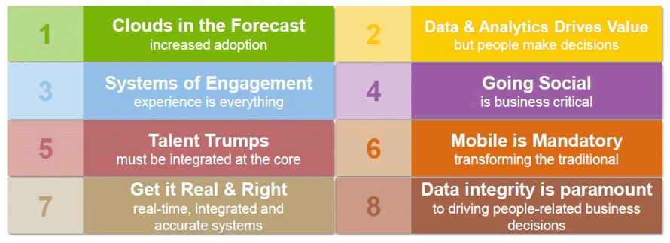
2023 Michigan CUPA-HR Conference
Remaining Relevant: A Focus on HR Agility
TECHNOLOGY
Key HR technology trends
www.hrexchangenetwork.com

Slide 9
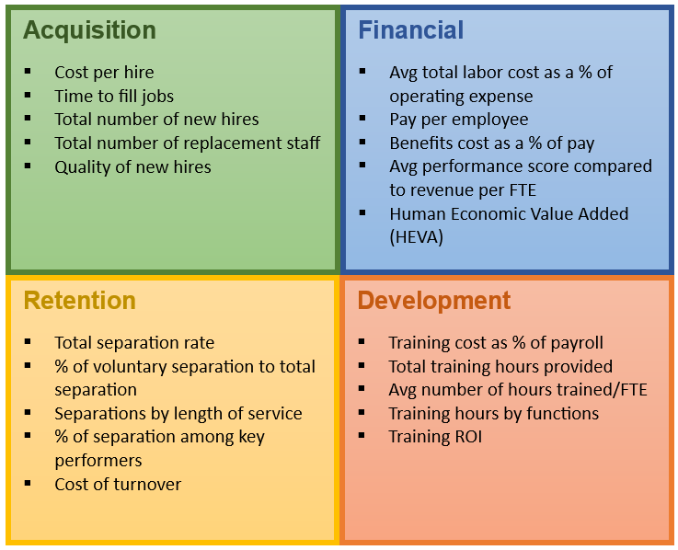
2023 Michigan CUPA-HR Conference
Remaining Relevant: A Focus on HR Agility
METRICS AND WORKFORCE ANALYTICS
What metrics should HR measure?
Customer’s perspective
Growth & learning perspective
Internal business perspective
Financial perspective
Notes:
Which Metrics Should HR Measure?
From the Customer’s Perspective: Executives will want to know how the company is being perceived by its’ customers. A few goals and measures can be used to answer this question, including customer satisfaction, sales trends, brand strength, market share, and customer loyalty.
From the Growth & Learning Perspective: Executives will want to know how the organization will continue to improve and create value. Measurements such as first to market percentage, number of development activities, and percentage of ready successors may help to ascertain growth and learning status.
From the Internal Business Perspective: What is the company doing well? Compiling data presented as trends related to compliance, workforce productivity, turnover rate, job fill rate, etc. will provide “actionable information” to justify new programs.
From the Financial Perspective: The leadership team of large organizations in reality, answer to the body of shareholders and stakeholders. Financial data and trends such as Earnings per share, growth revenue, budget accuracy, and profit/employee rates will provide an important picture of the overall viability of the organization. Some of the metrics, although financial, do involve HR and Workforce underlying data.

Slide 10

2023 Michigan CUPA-HR Conference
Remaining Relevant: A Focus on HR Agility
EMPLOYEE EXPERIENCE
MHealthy, University of Michigan

Slide 11
What are you doing
at your university?
MICHIGAN CUPA-HR
Thursday, July 27, 2023

