Slide 1
Generational Diversity
Notes:
Welcome & introduction
- Interactive training vs webinar with no interaction

Slide 2
Agenda
What is Generational Diversity?
Why is it important?
Why it matters.
Notes:
How does generational diversity fit into ALL categories. This is one piece of the pie, etc. Trying to get ahead of anyone coming with issues that there are "Bigger fish to fry" etc. pieces of puzzle

Slide 3
What is Generational Diversity?
The concept of having a wide range of generations in the workplace.
Notes:
Adults want to tie in their own experiences that they bring to the table. The earlier they can do that and participate, the earlier they will be hooked into the presentation. Can they share a time that age felt like a barrier to working successfully? What do they already know?

Slide 4
Social Generations
Groups of individuals of similar ages whose members have experienced a noteworthy historical event while young.
As a result of this experience, they develop a social consciousness or perspective that contributes to social change.
Within every generation are differing forms of response to historical situation, creating many “units” within a generation.
Notes:
Usually we think of genealogy – family lineage in conjunction with generations.

Slide 5
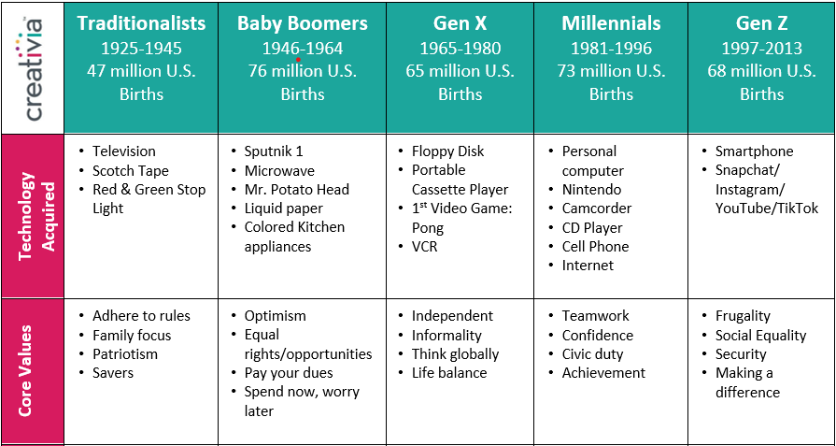
Gen Diversity Chart

Slide 6
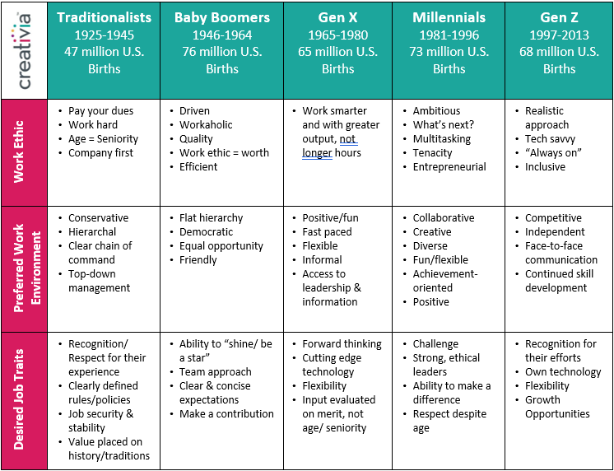

Slide 7
Clients or Customer
Team
Yourself
Notes:
Maybe pull the puzzle back in here to talk about perspective from white, female. Then turn it over to the group to consider their experiences.
What you want to do is have them start at themselves- where do they identify and what characteristics/descriptors do they relate to? Any they do not?
What generations do those on their team at work fall into? Where do they see the characteristics?
What generations do their clients fall into? Where do they see characteristics?
Where have they felt the difference? How does it show up?
Can they come up with a story or example to share?

Slide 8
Values Shared by Every Generation. Society for Human Resource Management – Survey Results
RESPECT
COMPETENCE
CONNECTION
AUTONOMY

Slide 9
Benefits of Generational Diversity
Knowledge Sharing
Leadership Development
Creativity & innovation
Notes:
Estimated that in 10 years most boomers will be retired. One org estimated that meant 700 retirements and 27,000 years of leadership.
By 2030 Millennials will comprise 75% of the workforce and they need to be prepared to lead.
It takes diversity of all kinds to create.

Slide 10
Consequences of not Having Generational Diversity:
It is hard to hire, engage, keep talent because youth like diversity.
It can be hard to find someone with prior knowledge to learn from.
Notes:
Young employees want to see other people like them in the workplace. Young employees are seeking diverse work environments
Mentorship is key to developing a young workforce, older workers must be retained as mentors.

Slide 11
Why is Generational Diversity a Challenge?
Generational Shaming
Age Biases
Value Perceptions
Knowledge Relevance
.

Slide 12
How do we Overcome Gen Diversity Challenges? Build Gentelligence®
1) Learn the differences in history and communication styles for each generation.
2) Resist Assumptions
3) Adjust the Lens
4) Strengthen Trust
5) Expand the Pie

Slide 13
Every Generation has something to teach and something to learn.
Promote Co-Mentoring

Slide 14
How will you become more age inclusive?
CUPU-HR Michigan. SHRM Activity: 22-G9U2A HRCI: 606592
Notes:
Have each person take a moment to reflect through what has been discovered today.
Consider how this applies to the job/how they will be held accountable.
Each person is to share one action step they are committed to.
Do they really connect with how this shows up in their life/work and how to start being better? If not, it can seem like a miss.

Slide 15
Certification credit
SHRM Activity: 22-G9U2A
HRCI: 606592

Slide 16
Thank you!
Website: getcreativia.com
Email: marycooney@getcreativia.com
Gentelligence® is the intellectual property of The Gerhardt Group, LLC

