Slide 1
CUPA HR Legal Update
 |  | NORTHERN KENTUCKY 109 East 4th Street Covington, KY 41011
Grant Garber
Vice President of Legal Affairs
and General Counsel,
Northern Kentucky University
Alexis Switzer
Associate, DBL Law
(859) 426-2110
aswitzer@dbllaw.com

Slide 2
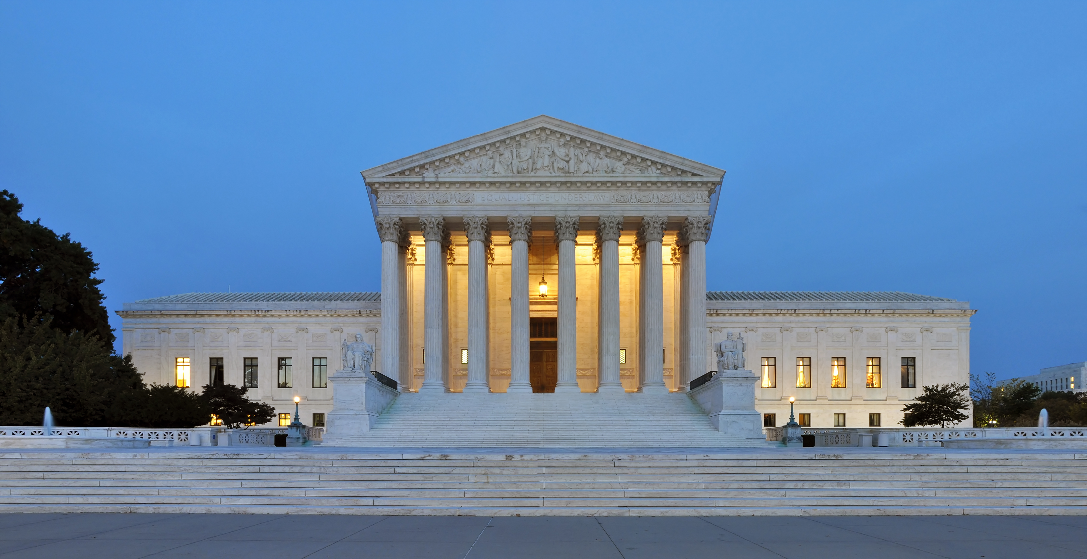
DIVERSITY in EMPLOYMENT Context: Students for Fair Admissions Cases
U.S. Supreme Court decision (June 2023): Harvard University and the University of North Carolina
Evaluated practice of using race as one factor in holistic assessment of undergraduate applicants.
“Eliminating racial discrimination means eliminating all of it.”
“Guarantee of equal protection cannot mean one thing when applied to one individual and something else when applied to a person of another color.”

Slide 3
DIVERSITY in EMPLOYMENT Anti-Discrimination Law & Trends
Unlawful for an employer to discriminate based on race with respect to hiring, discharge, compensation, and other terms of employment.
Equal Protection Clause of the 14th Amendment
Title VII of the Civil Rights Act
Kentucky Civil Rights Act
First Amendment, too…
…and retaliation claims.
“Reverse discrimination” cases have been uncommon – but early signs of an uptick
Possible Kentucky legislative activity in 2024

Slide 4
DIVERSITY in EMPLOYMENT Challenges and Tips for Higher Ed Employers
Clarity about the law and understanding of institution’s values and risk tolerance
Pressure-testing of hiring and other employment practices (eg, job postings, targeted recruitment, use of diversity statements, evaluation criteria, committee and hiring manager training, retention bonuses, internal discrimination reporting and investigation processes)
Fellowships and student employment
Stay tuned….

Slide 5
Title VII of Civil Rights Act – Religious Accommodation
Undue hardship
Determined whether an employer would be required to “bear no more than a de minimis cost” if it granted an employee’s religious accommodation request
If more than a de minimis cost, request was deemed to cause an undue hardship
Employer could lawfully deny the request

Slide 6
Religious Accommodation Example
Example – COVID-19
Vaccine mandate
Employee requests religious accommodation
Masking and testing – more than a de minimis cost?

Slide 7
Groff v. DeJoy
Supreme Court decision in the same day as affirmative action cases
Rejected longstanding precedent which required employers to show only that the accommodation would cause them to “bear more than a de minimis cost”

Slide 8
Groff v. DeJoy
Employers must prove “the burden of granting an accommodation would result in substantial increased cost in relation to the conduct of its particular business.”
Unclear how this is to be implemented – SCOTUS remanded case to lower courts for further review under “clarified standard”

Slide 9
Religious Accommodation – New Standard
Court’s decision heightens burden on employers to defend against such claims
Effectively requires employers to evaluate their own procedures for analysis of religious accommodations

Slide 10
Proposed Overtime Rule
Dept. of Labor (DOL) proposed overtime rule on August 30, 2023
Sets earning thresholds to help define and delimit the Fair Labor Standard Act’s (FLSA) ‘white collar’ or executive, administrative, or professional (EAP) exemption

Slide 11
Overview of FLSA
Fair Labor Standards Act
Workers who work more than 40 hours a week are entitled to overtime pay
Overtime pay = 1.5x regular rate, unless employee is exempted

Slide 12
Overview of FLSA
Exempt for being a “bona fide executive”:
Paid a predetermined and fixed salary
Salary must meet or exceed certain threshold
Must perform specific defined work responsibilities

Slide 13
DOL Proposed Changes to Overtime Rule
Increase proposed salary threshold from $684/week ($35,568/year) to $1,059/week ($55,068/year)
Increase salary threshold for highly compensated employees from $107,432 annually to $143,988 annually

Slide 14
DOL Proposed Changes to Overtime Rule
Implement automatic increases every 3 years
Apply standard salary level to employees in all territories subject to federal minimum wage

Slide 15
What happens next?
Public comment period for 60 days from the date of publication
May see challenges in court – last proposal in 2016 enjoined in court

Slide 16
PUBLIC EMPLOYEE SPEECH
Congress shall make no law respecting an establishment of religion, or prohibiting the free exercise thereof; or abridging the freedom of speech, or of the press; or the right of the people peaceably to assemble, and to petition the government for a redress of grievances.

Slide 17
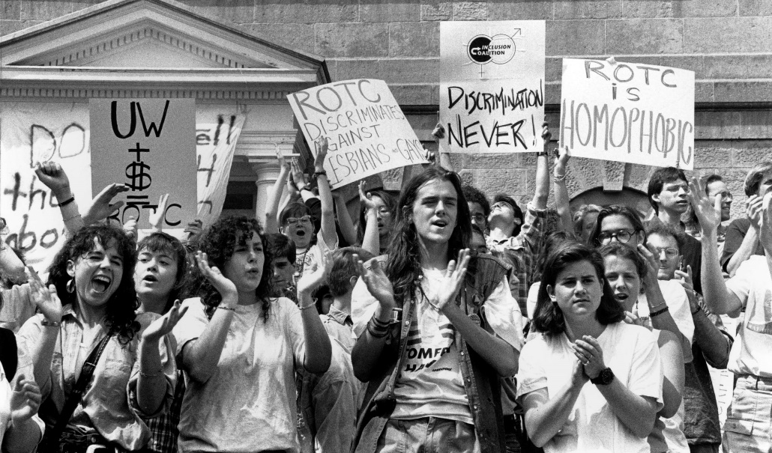
PUBLIC EMPLOYEE SPEECH
Employees “do not surrender all of their First Amendment rights,” but “when a citizen enters government service, the citizen by necessity must accept certain limitations on his or her freedom.”
Generally, speech permitted unless it causes substantial disruption or violates time / place / manner rule.

Slide 18
PUBLIC EMPLOYEE SPEECH Three-Part Test
(i) Pursuant to official duties? In furtherance of job responsibilities?
Was speaker representing the university (eg, social media)?
Communicating through chain-of-command?
Using workplace resources?
(ii) Citizen on Public Concern vs. Private Workplace Grievance? Political, social, or other debated issue of interest to community?
Was it publicly shared or communicated? (iii) Balance between Employee’s Free Speech Rights vs. Employer’s Ability to Manage Workplace
Employee’s position and functions? Context of speech?
Workplace efficiency and relationships?
**Academic freedom

Slide 19
PUBLIC EMPLOYEE SPEECH Example: University AVP-HR
AVP-HR at a regional public university.
Writes newspaper column critiquing / comparing civil rights movement with gay rights movement.
University disavows her views.
AVP says she spoke in personal capacity.
Pursuant to official duties?
Citizen on Public Concern vs. Private Workplace Grievance?
(iii) Balance between Employee’s Free Speech Rights vs. Employer’s Ability to Manage Workplace

Slide 20
PUBLIC EMPLOYEE SPEECH Example: Counseling Center complaint
Counseling Center employees do not like the new director.
They send memo to director’s supervisors and other executives alleging incompetence, poor training and communication, and other mismanagement.
University investigates and finds insufficient evidence.
Within a week, employees’ jobs are eliminated.
Pursuant to official duties?
Citizen on Public Concern vs. Private Workplace Grievance?
(iii) Balance between Employee’s Free Speech Rights vs. Employer’s Ability to Manage Workplace

Slide 21
PUBLIC EMPLOYEE SPEECH Example: Engineering Department disagreements
Concerns about engineering faculty regarding basic education quality issues and outcomes for students.
Series of department heads were criticized internally.
During accreditation review, faculty group formed own “committee” and created and distributed a report to leadership and accreditor.
“Academic terrorism”
Faculty were transferred.
Pursuant to official duties?
Citizen on Public Concern vs. Private Workplace Grievance?
(iii) Balance between Employee’s Free Speech Rights vs. Employer’s Ability to Manage Workplace

Slide 22
PUBLIC EMPLOYEE SPEECH Example: Faculty blog
Faculty maintained blog that was scathingly critical of administration.
University threatened to shut down the blog – which allegedly used university trademarks – based in part on failures of “civility and professionalism.”
Faculty sued.
Pursuant to official duties?
Citizen on Public Concern vs. Private Workplace Grievance?
(iii) Balance between Employee’s Free Speech Rights vs. Employer’s Ability to Manage Workplace

Slide 23
Providing Urgent Maternal Protections for Nursing Mothers Act (PUMP Act)
Passed in 2022
Enforcement provisions began April 28, 2023
Applies to employers with at least 50 employees

Slide 24
PUMP Act Requirements
Requires employers to provide private space to express milk that is not a bathroom
Enforced by Department of Labor
Break time can still be unpaid for hourly workers so long as pay is not otherwise required

Slide 25
Penalties for Violations of PUMP Act
Liable for unpaid minimum or overtime wages
Employment reinstatement and payment of wages lost
Potential economic losses and punitive damages
Potential liability for attorneys’ fees
Does not allow for compensatory or emotional distress damages

Slide 26
Pregnant Workers Fairness Act (PWFA)
Extended Americans with Disabilities Act to cover pregnant workers
Applies to employers with 15 or more employees
Goes into effect June 27, 2023

Slide 27
Requirements under PWFA
Must provide reasonable accommodations to pregnant employees
Must engage in interactive process
Enforce by Equal Employment Opportunity Commission (EEOC)

Slide 28
Kentucky Pregnant Workers Act
Been in effect since June 2019
Kentucky employers with more than 15 employees
For employees who are limited due to pregnancy, childbirth, and related conditions

Slide 29
Kentucky Pregnant Workers Act
Must provide reasonable accommodation
Unless it would impose an undue hardship to do so
Required to have a poster on the Act

Slide 30
Kentucky Pregnant Workers Act
Examples of reasonable accommodations:
More frequent or longer breaks
Time off to recover from childbirth
Acquisition/modification of equipment
Appropriate seating

Slide 31
Kentucky Pregnant Workers Act
Examples of Reasonable Accommodations:
Temporary transfer to a different job
Modified schedules
Light duty
Private space, other than a bathroom, to express breast milk

Slide 32
Remote workforce legal issues
COVID19 has raised a myriad of legal issues
Many employers have determined that remote work is acceptable and employees like the flexibility
I will address some of the issues that are raised by having employees work remotely
Healthcare has additional challenges with being remote

Slide 33
Benefits – for both parties
Work from home arrangements pose a number of benefits for employers and employees:
Allows for flexibility
Minimize contact among workers and clients to slow and prevent transmission of COVID-19
Increased productivity?
Cost saving – office leases, travel, etc.
Balancing family needs
Commute time

Slide 34
PRIVACY CONCERNS
HIPAA - healthcare
Access to computer files
Access to paper files
Confidentiality of calls/meetings
Computers and mobile devices password protected
Cybersecurity training

Slide 35
What are the legal issues?

Slide 36
TAX WITHHOLDING
General rule is to withhold where work is performed
Physical presence rule
Every state is different on how to withhold for remote workers
Ex: Indiana will not assert nexus if remote work is temporary and COVID related
Some states have issued guidance
Very fluid area
Must review laws of each state where employees work

Slide 37
TAX WITHHOLDING
General rule is to withhold where work is performed
Physical presence rule
Every state is different on how to withhold for remote workers
Ex: Indiana will not assert nexus if remote work is temporary and COVID related
Some states have issued guidance
Very fluid area
Must review laws of each state where employees work

Slide 38
Wage and Hour Issues
For hourly workers (non-exempt), need to track all hours worked
Require employees to certify that their recorded time is accurate
Line between work time and personal time is less clear
Important to keep time sheets
Wage and hour laws are particularly important to consider for non-exempt employees because of overtime pay issues
Notice of required posting should be available for remote workers
What state laws apply for wage and hour claims?
Probably state where employee works

Slide 39
WORKER’S COMPENSATION
Home offices may be an extension of workplace
If injured in course of work-related activities
Far less control over home office environment
Does the state where the employee is working allow reciprocity or will an employer have to enroll in WC program in each state?

Slide 40
REMOTE WORK …as a disability accommodation…
Interactive process is critical!
Blanket, cursory denials of accommodation requests create significant risk.
Emerging trend = Citing COVID-era experience as evidence re: essential functions and undue burden (“I did it well during COVID….”).
For public institutions – governmental immunity in ADA claims

Slide 41
1024492.1

