Slide 1
Beyond Borders:
A Step by Step Guide to Hiring and Employing Remote Workers

Slide 2
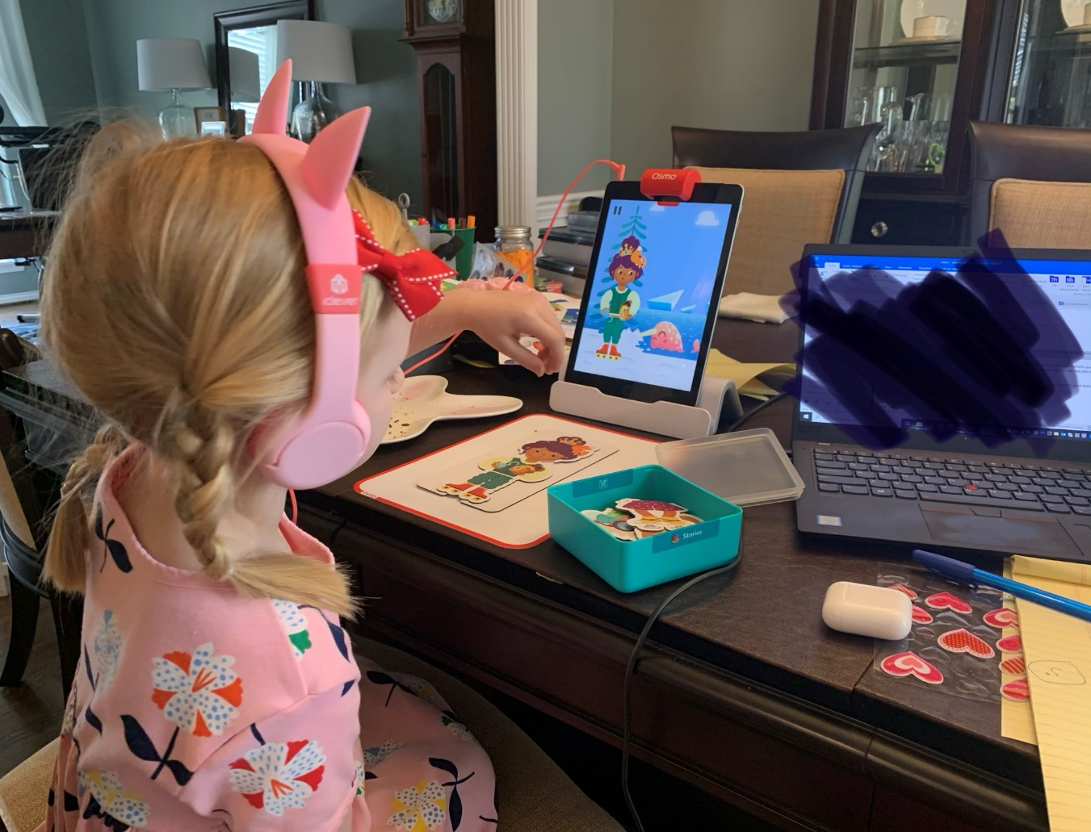
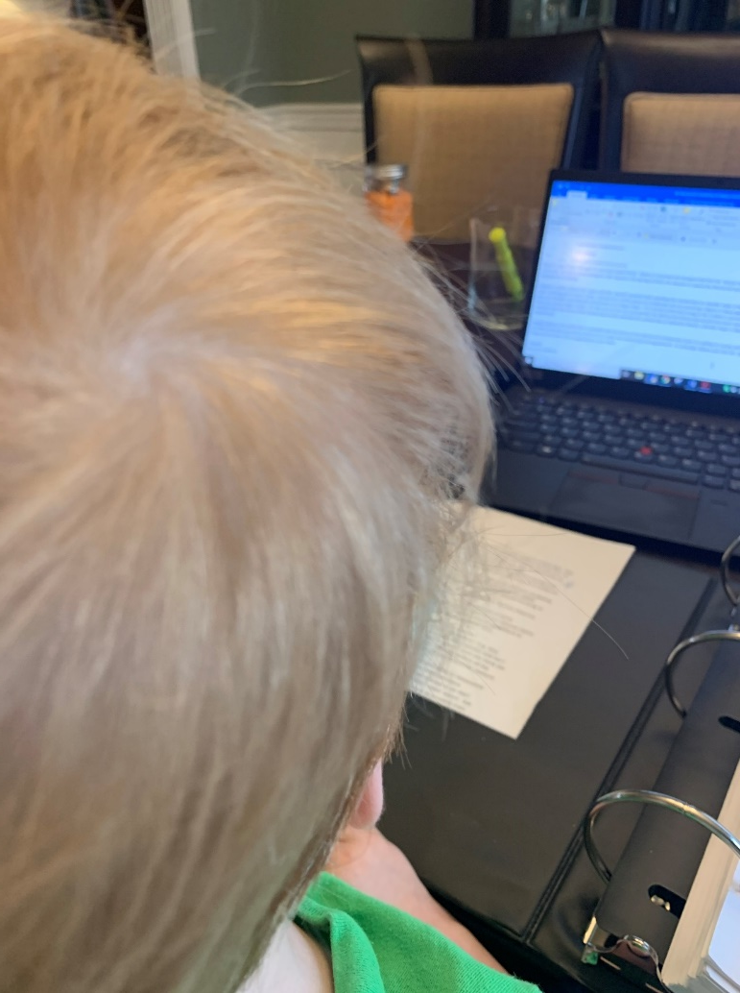
Notes:
It wasn’t that long ago when many of us were forced to go from working in an office every day to 100% remote work. This is what that looked for me, and I distinctly recall handling many phone calls, conference and even court appearance while hiding from my children in my closet.
Thankfully, things have improved a bit since then, and many people have really committed to the whole Remote Work idea.

Slide 3
Notes:
Theresa Feulner lives on a sailboat with her partner while traveling the world.
She works part-time as a remote psychologist specializing in dating and relationships.
While she's had to adapt to living at sea, Feulner said she loves the freedom her lifestyle allows.

Slide 4
Notes:
The Seattle Mariners hosted a Work From The Ballpark Day on September 7th.
It's the latest tactic in the competition to attract remote workers.
It comes as Major League Baseball faces a long-term decline in attendance.
On September 7, a Wednesday, the Seattle Mariners hosted a Work From The Ballpark Day during the team's series finale against the Chicago White Sox — becoming the first Major League Baseball team to turn the ballpark into an untraditional coworking space.
For $50, fans received a meal, wifi access, and a seat in the stadium's Hit It Here Cafe located in the second deck beyond right field. The workspace was available from 11:00 AM through the end of the 1:10 PM contest — the average baseball game lasts just over three hours.
While the Mariners fell by the score of 9-6, the franchise won — selling out each of the 150 passes that were made available.

Slide 5
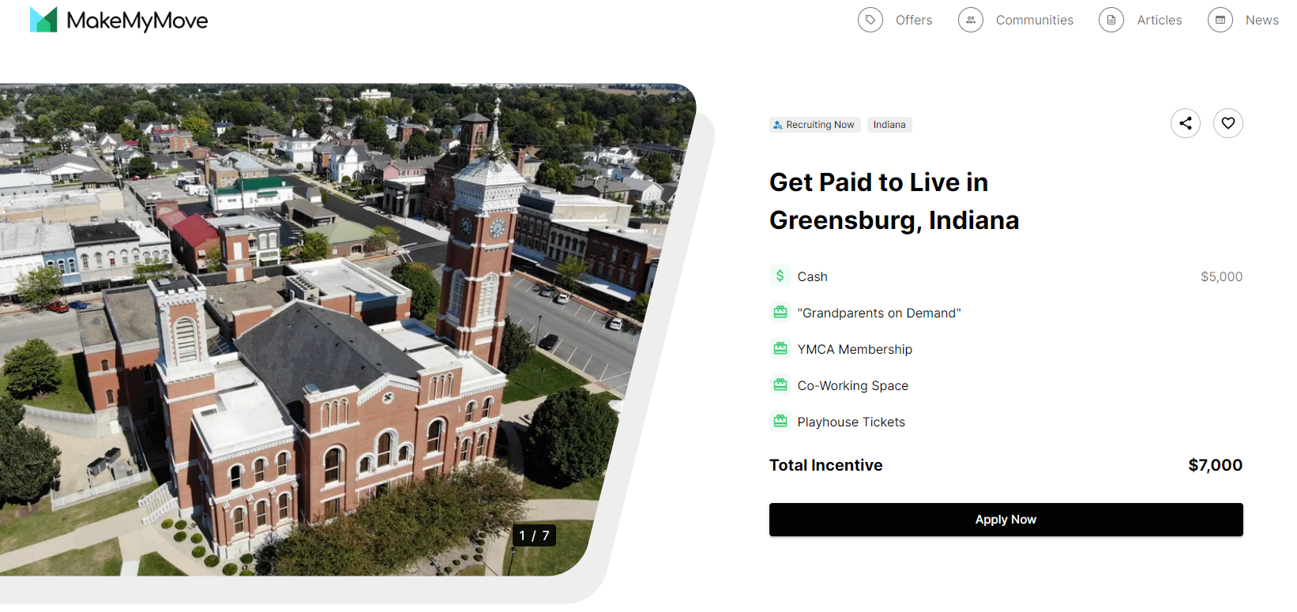
Notes:
But the perks go beyond a town covering closing costs on a new home, with quirky offerings that suggest a desire to build community. In Greensburg, Ind., parents can take advantage of the “Grandparents on Demand” package, which provides applicants with babysitting hours free of charge. (And not just any babysitter, according to the description on MakeMyMove, but "our friend Tami at the Decatur County Community Foundation and her husband (who also drives the school bus) happily offer babysitting hours and will stand in on Grandparents Day at school.")
Other towns offer free concert tickets or lifetime memberships to a local deli co-op.
Communities across the U.S. spend $70 billion annually to grow their economy, says Hock. In the past, this money was frequently used to incentivize companies to move, but now townships can go straight to the remote employer instead.
“Now that millions of workers are geographical free agents, many of those communities are redirecting their funds to recruit the workers directly. These remote workers bring their families, their income, their spending power, and their taxes. For a modest investment, the returns are enormous,” says Hock.

Slide 6
Notes:
Some states are trying to gain that edge by essentially buying talent. West Virginia is offering $20,000 in cash and incentives to people willing to move to the state and live there for two years. In its first two years, the public-private partnership known as Ascend West Virginia says it has accepted 86 new workers among thousands of applicants, many of them relocating with spouses and family members. The program aims to attract more than 1,000 workers to the state over five years.
1 & 2. Morgantown and Lewisburg, West Virginia
Description: These West Virginia cities have an abundance of hiking and scenic views from the nearby Appalachian mountains. As John Denver once sang, "Take me home, country roads."
Estimated value of incentive: $20,000
Who qualifies: Applicants with a full-time remote job in a company not based in West Virginia
Package: A cash stipend of $12,000 and undisclosed gifts and incentives valued at $8,000

Slide 7
Notes:
Portugal is the latest country to formally position itself as a haven for “digital nomads,” as it introduces a new visa geared toward remote workers that will become available Oct. 30.
With its comparatively low cost of living, temperate weather and proximity to other European destinations, Portugal has grown in popularity as a destination not only for travel but also for longer-term relocation, including retirement.
The digital-nomad visa and residence permit will be available for people employed outside of Portugal who are able to provide a contract of employment, tax residency documents and proof of an average monthly income over the past three months equivalent to at least four times the minimum wage in Portugal, or roughly $2,730. For salaried workers, an annual salary of about $32,760 would suffice. That’s just under half of the average annual salary of U.S. remote workers, according to jobseeker site ZipRecruiter.

Slide 8
Remote Work is Here to Stay
Nearly 57% of the remote workforce either rarely or never worked from home prior to COVID-19.
97% of remote employees want to continue working remotely until the end of their careers.
25% of professional jobs in North America are expected to be remote by end of 2022, and continue to grow in 2023.
So what can you do about it?
Notes:
Remote & Hybrid jobs attract
seven times more applicants.
- CNBC 3/4/22
(Career Builder research)
After being forced to adapt to remote work during the pandemic, businesses are now faced with a professional workforce that is largely unwilling to work wholly in-person. Most businesses have responded by allowing remote or hybrid models for certain workers. As the job market only gets more competitive, remote work is here to stay.
Remote work provides workers with greater flexibility as to where they live and work. While some workers have relocated or obtained positions in locations far from where they live, others may use the opportunity to travel more often.
“The idea of a full return is dead.”
– Nicolas Bloom, Stanford Economics Professor (quoted by NBC News)
As a result, businesses are increasingly dealing with workers across multiple state lines, making compliance with employment laws more difficult.

Slide 9
Initial Considerations
Discuss sooner rather than later.
CUPA-HR reports that nearly half of the people working in higher education are considering looking for employment elsewhere in 2022, citing “misalignment” between their current work arrangement and their preferred work arrangement as primary factor
Does it work for your institution and/or employees?
Notes:
While most workplaces have continued to allow employees to work remotely over the last year or so, higher education has been slower to come around, largely pining for a return to “normal” that is not only unlikely to ever arrive, but harkens back to inefficiencies centered on tradition rather than the needs of its evolving customers. That traditional model is unable to attract and retain the talent that it needs to survive and thrive.

Slide 10
Pre-Hiring Phase
Where does the employee actually work?
Generally, where he or she performs work.
Notes:
I do not practice law in every 50 states, nor am I allowed to. =) The goal of this presentation is to give you an idea of the types of issues that will arise during each stage of the employment process so these things are on your radar. As you know, employment laws can change drastically from state to state, and we can’t cover them all, but I’ve tried to point out some interesting requirements in other states.
There are few, if any, instances where the legal analysis of an employment law question is the same for all 50 states.
Federal law sets minimum standards for businesses to follow when employing workers, including W2 employees and independent contractors. While some states rely heavily on those standards, others almost always provide employees with more protection. States cannot provide workers with less protection due to the Supremacy Clause.
Depending on the state and industry, there may be additional requirements to follow even before you hire a worker.

Slide 11
Pre-Hiring Phase
Salary History Restrictions
Colorado – cannot seek applicant’s wage history or use it as basis for future salary; cannot be used to justify wage disparity
Illinois – cannot screen applicants by requiring their salary history; cannot be required as part of condition of employment
In the event of voluntary disclosure, salary history may not be used to determine future wages or whether to hire

Slide 12
Pre-Hiring Phase
Salary History Restrictions
Alabama – employer may inquire into wage history and use it to determine compensation, but may not use information to refuse to interview, hire or promote employer; no retaliation
Ohio (Cincinnati and Toledo only) – In Cincinnati, may not inquire about salary history or search public records; screen applicants; or rely on history to determine future wage (does not apply to voluntary disclosures)

Slide 13
Pre-Hiring Phase
Social networking and other online searches
Arkansas – may not request or require employees or applicants to provide social media information
California – same but with limited exceptions
Colorado and Virginia – also prohibit employers from suggesting or requiring employees “add” anyone else
Several states do not regulate this area, including Florida, Indiana and Ohio
Notes:
Alabama's law is the most common for states with social networking statutes

Slide 14
Pre-Hiring Phase
Consider Workers’ Compensation
Most states require private employers with at least one employer to carry worker’s compensation insurance
Some exceptions for small employers
Workers’ compensation coverage is optional in Texas
Notes:
In most states, businesses are required to maintain or pay into funds to support insurance to protect their workforce, including:
Workers' compensation insurance.
Unemployment insurance.
State disability insurance. These insurance schemes are administered by state law, and apply in all jurisdictions where a business has employees

Slide 15
Pre-Hiring Phase
Consider Unemployment Insurance
Ohio – $530 maximum weekly benefit if no dependents; $642 for up to two dependents and $715 for three or more; up to 26 weeks
North Carolina – $350 for 12 to 20 weeks (depending on state unemployment rate)
Massachusetts – $974 plus $35 per child for 30 weeks
Florida – $275 for 12 weeks
Notes:
Typically a state's labor or employment development department determines whether an unemployed worker qualifies for unemployment benefits after a worker files an application and the employer has had a chance to respond. Remember that Unemployment benefits generally are not available to independent contractors.
KENTUCKY’S MAXIMUM WEEKLY BENEFIT IS $569 FOR 26 WEEKS

Slide 16
Pre-Hiring Phase
Background checks
Electronic signatures comply with FCRA
Does the state have its own equivalent to the FCRA?
Yes: Texas, Arizona, California, Colorado
No: Florida, Ohio, Indiana, Illinois, Michigan
Notes:
Fair Credit Reporting Act

Slide 17
Pre-Hiring Phase
Tax Considerations
Duration of the remote work arrangement will impact tax withholding
Instruct employee to seek independent legal advice regarding their own tax liability
States that do not charge income tax: Alaska, Florida, Nevada, New Hampshire, South Dakota, Tennessee, Texas, Washington, and Wyoming.
Notes:
Your employee will probably be required to file a state return in the state where they reside (assuming their state imposes an income tax), as well as the state where you conduct business.

Slide 18
Pre-Hiring Phase
Tax Considerations
Consider state reciprocity rules to avoid double taxation
Applies to employer and employee
Several states apply a “convenience of employer” test to determine taxation of employee’s wages
Arkansas, Delaware, Nebraska and Pennsylvania
Notes:
Federal law prevents two states from being able to tax the same income. If the states do not have reciprocity, then you’ll typically get a credit for the taxes withheld by your work state.
Under the convenience test, a nonresident employee’s income is sourced to their physical location only if the employer requires them to work remotely. But, if you’re working remotely for your own convenience, your income could be taxed by your employer’s state. Since each of these states has its own criteria, you’ll want to check the Department of Revenue website from your employer’s state to find out how the convenience test applies to you.

Slide 19
Pre-Hiring Phase
Corporate tax obligation
Triggered when company is “doing business” in a particular jurisdiction but differs by state and locality
General rules:
Payroll for single remote worker is usually insufficient to trigger tax liability (unless a bona fide place of business exists in the state/locality)
Sale of services in a state will trigger liability

Slide 20
Pre-Hiring Phase
International considerations
How long should employee remain abroad?
Must countries require individual to file as a tax resident and pay income taxes if they stay for more than six consecutive months.
U.S. has entered into tax treaties will many countries to avoid double taxation for employee overseas
Consider employer of record (EOR) that specializes in these issues
Notes:
More than 20 counties across the globe offer specialized visas called DIGITAL NOMAD VISAS that let foreigners live and work remotely within their borders.
Most countries have tax-residency rules that dictate how long you can stay in their country before becoming a tax resident. In most cases, you must file as a tax resident and pay income tax if you stay for more than six consecutive months in a year.
Tax-residency rules also apply to contractors and part-time workers, especially in regards to reporting taxes. For instance, in the United States, foreign contractors must file a Form 1042 with the IRS, also known as the “Annual Withholding Tax Return for U.S. Source of Income of Foreign Persons.”
Both the U.S. and UK have worked to enter mutual and reciprocal agreements with more than 140 countries, including China and Russia. These tax treaties create exemptions that help professionals living abroad avoid double-taxation and pay fewer taxes. In the U.S., for example, the Foreign Earned Income Exclusion gives citizens and residents the opportunity to exclude up to $112,000 in income earned overseas.
An employer of record (EOR) is an organization that serves as the employer for tax purposes while the employee performs work at a different company. The EOR takes on the responsibility of traditional employment tasks and liabilities such as payroll, filing taxes, handling unemployment, etc.. An EOR is a cost-effective way to outsource payroll and HR functions. The business pays the EOR a set rate for every hour the employee works, and the EOR handles all tasks.
The employee still works for the business, but the employer of record handles payroll and HR issues in that local country. This enables the business to expand globally, without having to establish an entity or worry about local employment laws and taxes. With the rise of remote work trends, global EORs are poised to be a vital part of the global employment ecosystem for companies that want to hire anyone, anywhere.

Slide 21
Onboarding
State Reporting Obligations
New York: NYS registration Form 100 and report identifying information about employees to Department of Taxation and Finance within 20 calendar days of hiring date
California – report all new or rehired employees to New Employee Registry within 20 days of first day of work
Notes:
Most states require some form of employee registration for purposes of tracking child support obligations, state taxes, workers' compensation, and unemployment insurance (see Workers' Compensation and Unemployment Insurance).

Slide 22
Onboarding
Establish system for obtaining and managing electronic documents and signatures
New hire paperwork, including benefits enrollment forms, handbook, immigration compliance through deputized agent
Timekeeping records
Ensure that online systems are accessible to individuals with disabilities
Notes:
Completing required immigration documents can be more complicated for employers with a remote workforce. Within three days after an employee begins working for the employer, IRCA requires employers to:
Review new employees' original documents proving identity and employment authorization.
Complete Section 2 of Form I-9.
The Form I-9 process is typically completed at the employer's worksite during the employee's first three days after starting work. However, if an employer hires a remote employee located far from any of the employer's worksites, the employer needs to use an alternative method. IRCA allows an employer to deputize an agent to review documents and sign the Form I-9 for the employer. Because the employer remains liable, the agent must be trustworthy and someone with which the employer feels comfortable.
Although employers commonly seek licensed individuals like notaries public, attorneys, or certified public accountants to act as their agent, there is no rule under IRCA specifying what the agent must be. However, some state laws restrict which parties can complete immigration forms (see, for example, Cal. Bus. & Prof. Code § 22441(a)(1)). Either the remote employee or the agent may transmit the Forms I-9 to the employer.

Slide 23
Onboarding
Wage Theft Prevention Acts
Enacted in at least 12 states, including New York, New Jersey, California, Connecticut and Illinois, and D.C.
Requires:
Written notice of certain wage-related information such as wage rates and pay period
“Doing business” name of employer and contact information

Slide 24
Onboarding
Pay Frequency
At least semi-monthly – Nevada
Employer must designate two or more days each month as fixed pay days and cannot be more than 16 days apart – Arizona
Monthly or semi-monthly at the election of the employee – Alaska
Weekly or bi-weekly – Massachusetts
Notes:
Kentucky is at least semi-monthly

Slide 25
Onboarding
Workplace posters
If the employer regularly visits campus or a particular location, required posters in that location are sufficient.
“Electronic posting” on website or intranet, direct mail and e-mail distribution are generally permitted
DOL suggests posting notices and links to posters on website where job postings are listed

Slide 26
Onboarding
Workplace posters
Most states have their own required posters that may include:
Minimum wage
Workers’ compensation and unemployment insurance notices
Written notice of pay rate, hours of employment and pay schedule (see Wage Theft Prevention)
Protected and/or paid leave, if applicable

Slide 27
Onboarding
Restrictive covenants
State law varies regarding enforceability and scope
Some states require additional consideration for obligations in the agreements
Notes:
Courts in most states recognize that non-competes limit an individual's ability to make a living and will not enforce non-competes that restrict employees beyond what is reasonably necessary to protect a legitimate business interest (see, for example, BDO Seidman v. Hirshberg, 93 N.Y.2d 382, 388-89 (1999)). Some non-compete agreements limit the restriction to a defined group of competitors or to a specified geographic region to comply with state law. In other jurisdictions such as California, post-employment non-compete agreements with employees are illegal, except in very narrow circumstances involving the sale of a business (see Standard Clause, Non-Compete Provision (CA): Drafting Note: Read This Before Using). Though not as restrictive as California, Massachusetts and Illinois law both impose significant restrictions on the enforceability of non-competes. Other states have restricted the use of non-competes with certain categories of employees, such as workers earning less than a specified annual compensation (see Practice Note, Non-Compete Agreements with Employees: Limitations on Non-Competes with Low-Wage Workers).

Slide 28
Employment
Classification laws
States have different tests for salary thresholds and job duties for exempt classifications
Independent contractors
Some states, including New Hampshire and Massachusetts, have their own tests
Notes:
In other words, an individual in a certain position could be exempt in one state but not another.

Slide 29
Employment
Minimum Wage
The minimum wage in many states and localities exceed the current federal minimum wage of $7.25 for non-exempt employees.
Must pay the greater of all applicable minimum wages.
Notes:
Covered employers must pay the greater of any applicable federal, state, or local minimum wage.
Kentucky's minimum wage is required by state statute to track the federal minimum wage if the federal minimum exceeds $7.25. The Kentucky supreme court held a Louisville minimum wage ordinance invalid as impermissibly conflicting with the state minimum wage. The decision affects a similar ordinance in Lexington. (Kentucky Rest. Ass'n v. Louisville/Jefferson Cty. Metro Gov't, 501 S.W.3d 425 (Ky. 2016).)

Slide 30
Employment
Ohio – $9.30 for most employers; $7.25 for employers that gross less than $342,000 annually
Indiana, Texas and North Carolina – $7.25
Illinois – currently $12, increases to $15 by 2025
Higher in Chicago
New York – $15 in several counties, $13.20 for remainder of state (with annual increases to $15)
Notes:
Covered employers must pay the greater of any applicable federal, state, or local minimum wage.
Kentucky's minimum wage is required by state statute to track the federal minimum wage if the federal minimum exceeds $7.25. The Kentucky supreme court held a Louisville minimum wage ordinance invalid as impermissibly conflicting with the state minimum wage. The decision affects a similar ordinance in Lexington. (Kentucky Rest. Ass'n v. Louisville/Jefferson Cty. Metro Gov't, 501 S.W.3d 425 (Ky. 2016).)

Slide 31
Employment
Hours worked and overtime
Compensable time if employer knows or has reasonable belief that work is being performed (including unauthorized work)
Employer bears responsibility to maintain accurate time records
Providing a reasonable procedure for reporting working time (including unscheduled work) is generally sufficient
Notes:
Line between compensable time and non-working time is not always clear with remote work.
Employers must pay for all work they know or have reason to believe is being performed, including unauthorized work.
Employers can satisfy their obligation to exercise reasonable diligence to track working time by providing a reasonable procedure for reporting unscheduled work.
Reporting procedures are not reasonable if an employer:
prevents or discourages employees from reporting working time;
does not provide proper training on the procedure; or
requires employees to waive their right to compensation for hours worked.
Employers are not required to take impractical steps to identify unreported work if employees do not use the available reporting procedure and the employer is not otherwise notified of the additional work time.
State and local law often imposes different or additional wage and hour requirements. Employers must comply with the applicable federal, state, or local law that provides the greatest employee rights and protections. :

Slide 32
Employment
Paid Sick Leave
No federal law requires mandatory paid sick leave (some exceptions for federal contractors)
Maine and Nevada allow paid leave for any reason – not just sick leave
More than 30 states and localities require paid sick leave
Notes:
Employers with workers in any of the cities or states with paid sick leave laws in effect or scheduled to go into effect must review their leave policies and confirm that they satisfy each of the applicable laws' requirements. In addition to ensuring they accrue and allow usage of sufficient paid leave, employers must comply with all aspects of these laws, including recordkeeping, notice and posting and confidentiality requirements. Employers should keep abreast of continued developments at the state and local levels where they employ workers

Slide 33
Employment
Paid Sick Leave
Arizona – accrual of 1 hour of leave for every 30 hours worked (capped at 40 hours for large employees and 24 for small employers)
California – frontloaded grant of 24 hours per year or allow employees to accrue over time (additional sick leave for COVID) plus MANY different local ordinances

Slide 34
Employment
Paid Sick Leave
Georgia – up to 5 sick days to care for immediate family member for employers with more than 25 employees
Michigan – accrual of 1 hour of paid leave for every 35 hours worked (may be capped at 40 hours) for employers with more than 50 employees
Texas – statewide law enjoined but local ordinances require different amounts

Slide 35
Employment
Paid Family Leave
New Jersey – 12 weeks of additional bonding leave that applies to “all employees” of an “employer”
Could potentially apply to employees in different states
Oregon’s family leave law only applies to employers with 25 or more employees within the state
Georgia’s Kin Care law applies to employers with 25 employees regardless of location
Notes:
At least 10 states offer paid family leave

Slide 36
Employment
Paid Family Leave
Connecticut – only applies if employer has 75 or more employees within Connecticut
Florida does not have family/medical leave provision but Miami-Dade County does (must have at least 50 employees in the county)
Notes:
At least 10 states offer paid family leave

Slide 37
Employment
Anti-discrimination laws and ordinances
Kentucky – status as smoker or non-smoker
Florida – has or is perceived to have AIDS or HIV
Miami-Dade County – source of income; actual or perceived status as a victim of domestic violence, dating violence, or stalking
Michigan – arrest record; height and weight
Notes:
on June 15, 2020, the US Supreme Court held that failing or refusing to hire, discharging, or otherwise discriminating against a person because they are homosexual or transgender is illegal discrimination based on sex under Title VII of the federal Civil Rights Act of 1964 (Bostock v. Clayton Cty., Ga., 140 S. Ct. 1731, 1737 (2020)).

Slide 38
Employment
CROWN Acts
No discrimination based on natural or traditional hair styles, such as locs, braids, and twists.
Enacted in California, New York, New Jersey, Virginia, Colorado, Washington, Maryland, Connecticut, New Mexico, Delaware, Nebraska, Nevada, and other states.
In Kentucky: Covington & Louisville
Notes:
A Black woman is 80% more likely to change her natural hair to meet social norms or expectations at work¹
Black women are 1.5 times more likely to be sent home or know of a Black woman sent home from the workplace because of her hair¹
1 in 2 Black children have experienced hair discrimination as early as five years old – and the impact can last a lifetime
The CROWN Coalition sponsored The CROWN Act (SB 188) in California, introduced by Senator Holly J. Mitchell. California was the first state to sign The CROWN Act into law on July 3, 2019. The CROWN Act and laws inspired by the CROWN Act have been enacted in 19 states: California (2019), New York (2019), New Jersey (2019), Virginia (2020), Colorado (2020), Washington (2020), Maryland (2020), Connecticut (2021), Delaware (2021), New Mexico* (2021), Nebraska* (2021), Nevada (2021), Oregon* (2021), Illinois* (2021), Maine (2022), Tennessee* (2022), Louisiana* (2022), Massachusetts (2022) and Alaska* (2022). Additional bills are awaiting governor's signature in Alaska and Illinois*. In 2021, Illinois original bill, Senate Bill 3616 was a protection for schools ONLY; the new amendment to SB3616 would add the protection of workplaces as well.
On March 18, 2022, the U.S. House of Representatives passed the CROWN Act, and if a companion bill passes in the Senate, it would make hair discrimination based on the texture of natural hair illegal under Titles VI and Title VII of the Civil Rights Act of 1964, the Fair Housing Act, and other Federal civil rights laws.

Slide 39
Employment
Contractual limitations
Illinois – may not prohibit employee from making truthful statements or disclosure regarding unlawful employment practices
Tennessee – may not require employer to sign non-disclosure agreement regarding sexual harassment in workplace as a condition of employment
Virginia – may not force employer to conceal details of sexual assault claim
Notes:
Remember that in February 2022, Congress passed H.R. 4445, the Ending Forced Arbitration of Sexual Assault and Sexual Harassment Act of 2021. This law, signed by President Biden on March 3, 2022, amends the FAA to render unenforceable (at the claimant's option) predispute arbitration agreements and joint-action waivers regarding sexual assault and sexual harassment disputes
Many states have passed laws that provide greater sexual harassment protections to employees and impose more requirements on employers. To bring attention to these claims and prevent employers from shielding wrongdoers, some state laws specifically address settlement agreements and other employment-related agreements that potentially "silence" sexual harassment (or similar) claims

Slide 40
Employment
Reimbursements for business expenses
Not required under FSLA (unless work expenses cause employee to drop below minimum wage)
At least fifteen states and some cities require reimbursement for “reasonable” or “necessary” costs of job performance, including California, Illinois, Montana, New York, and Iowa
Courts in California and Illinois have held that remote work expenses fall within reimbursement laws
Notes:
While there are no federal requirements for reimbursing remote work costs for your employees, some states and cities have enacted stricter employee expense laws. It’s best to have a written employee expense reimbursement policy in your employee handbook to ensure your organization has an action plan for remote workers.
For example, California requires employers to reimburse employees when they are required to use their personal cellphones for work even if there is no increased cost to the employee.
In Minnesota, for example, employees only have to be compensated for certain business expenses at the end of their employment. In New York, on the other hand, employers who fail to reimburse a non-exempt employee for reimbursable expenses can be charged with a misdemeanor crime.

Slide 41
Employment
Stipend?
Some employers offer a monthly stipend for remote work expenses
Allows employees to request (and document) reimbursement for approved expenses such as phone, internet, home office supplies, etc.
Reimbursements are generally taxable
Notes:
offering a remote work stipend to your employees can help you compete with organizations that don’t provide a remote work benefit.
With a remote work stipend, you can offer your employees a monthly allowance for their home office costs. This can include phone and internet bills and home office setup costs.
It works like this: you set up a monthly benefit allowance for your employees. You can either give all employees the same allowance or give certain employee classes (such as full-time) or employees in certain states a larger allowance. You can also choose to only offer the benefit to employees in certain states or classes.
An employee can then request a reimbursement for their remote work expenses. You’ll simply approve these amounts up to their eligible allowance. Typically, you’ll reimburse your employees on their next paycheck.
Because remote work employee stipends are taxable income, they have to be reported on their W-2s.
Employee stipends allow your remote workers to cover their employee expenses quickly and flexibly, all while satisfying state requirements for remote work expenses.

Slide 42
Employment
Paycheck deductions under FLSA:
Violation if wages minus expenses are below minimum wage for non-overtime workweek.
Permits deductions to recover advances or loans to employees even if the deduction cuts into a non-exempt employee’s minimum wage or overtime pay
Cannot deduct attorneys’ fees, interests or expenses if they bring pay below minimum wage/impact overtime wages
Notes:
Circumstances can arise, however, when the employer seeks to recover money from an employee, including when the employer:
Overpays wages to the employee inadvertently through a mathematical or clerical error.
Advances pay to the employee.
Loans money to the employee.
Employers sometimes seek to recover money from employees in other situations, such as when the employee:
Damaged or destroyed the employer's property or equipment through negligence or carelessness.
Directly or indirectly took an action (or failed to take an action) that resulted in the employer losing business, customers, or clients.
According to these DOL opinion letters, the FLSA does not prohibit wage deductions to recover pay advances or loans to an employee, even if the deduction cuts into a nonexempt employee's minimum wage or overtime pay. The only requirement imposed by the DOL is that attorneys' fees, interest, and expenses may not be deducted if that deduction brings the employee's pay below the minimum wage or cuts into any overtime pay the employee earned.
However, the FLSA does not address the mechanics of how an employer may go about making a wage deduction, beyond the DOL recommending (but not requiring) that employers obtain an agreement in writing in which the employee both:
Acknowledges the wage overpayment or advance.
Agrees to the deduction.
This area is largely governed by state law, so employers must be aware of individual state laws addressing permissible and prohibited wage deductions.

Slide 43
Employment
Paycheck deductions
Most states permit garnishments for legal obligations such as child support
Many limit the garnishment to no more than 25% of the employer’s wages

Slide 44
Employment
Paycheck deductions
Many states prohibit withholding any portion of an employee's wages without his or her prior written authorization (and only for certain deductions)
Indiana – permits employee to revoke authorization for deductions at any time and specifically requires employer to provide written authorization within 10 days of execution of deduction
Notes:
Examples of permitted deductions with written authorization:
hospitalization and medical insurance;
other insurance;
savings plans;
stock purchases;
voluntary pension plans;
charities; and
deposits to financial institutions.
parking

Slide 45
Employment
Examples of prohibited deductions in Arkansas:
Spoilage or breakage.
Cash or inventory shortages or losses.
Fines or penalties for lateness.
Misconduct.
Quitting by an employee without notice.

Slide 46
Employment
Colorado permits:
Deductions to compensate for an employee's theft if the employer filed a report with the proper law enforcement agency, pending a final decision by a court
Ohio permits:
Deduction for damaged or destroyed tools and machinery if employer has an express contract with employee

Slide 47
Employment
North Carolina permits deductions for cash shortages, loss or damage to employer’s property, principal amount of loans to employee, etc. if:
Employee is given written notice of the amount to be deducted at least seven days before the payday on which the deduction is made (but not required when a separation occurs)
However, cannot make deductions from any overtime hours or non-overtime wages below minimum wage

Slide 48
Employment
Remote Work as an Accommodation
EEOC recognizes it as a potential reasonable accommodation
If other employees are permitted to work remotely, it must be an option for disabled employees.
Marginal or minor job duties may need to be re-assigned if they are the only obstacles to remote work.
Engage in interactive process for any requests that accompany remote work, such as home equipment.
Notes:
Employers do NOT need to remove any essential job functions BUT Marginal or minor job duties may need to be re-assigned if they are the only obstacles to remote work because they cannot be performed outside the workplace
Courts, for example, have refuse to require an employer to cover 4K work from home stipend and a new computer. One court in Massachusetts, however, found that employer was required to provide an adequate office and technical assistance and adequate computer access.
The EEOC has a veru helpful fact sheet on remote work as a reasonable accommodation if you are interested.

Slide 49
Post-Employment
Mini WARN Act
California, Iowa, Maryland, New York, Tennessee, for example
Several states that do not have a mini-WARN act still require notice to the state DOL for layoffs involving a certain number of employees OR the business is sold

Slide 50
Post-Employment
Final paycheck rules
California and Nevada – all wages, including accrued vacation, are due immediately upon involuntary termination
Alaska – all final pay is due within three working days for terminations
Texas – within six days if employee is terminated
Returning company equipment

Slide 51
Challenges
Keeping it all straight!
Recruiting and retaining employees on campus that want to work 100% remotely.
Embracing and including remote employees in in-person locations.
Pay equity when employees work in different locations.
What challenges are you facing?
Notes:
HR people need to be involved in these conversations and strategic plans!

Slide 52
Courtney Ross Samford
courtney.samford@dinsmore.com
(859) 425-1092

